Slide 1
Scriptural Constraints and Philosophical Solutions: Different Understandings of Time in Augustine’s Commentaries on Genesis
The Oxford Medieval Commentary Network Conference
Christ Church, Oxford, 29th September 2022
Jiachun Xu 徐佳淳 xujiachun808@pku.edu.cn

Slide 2
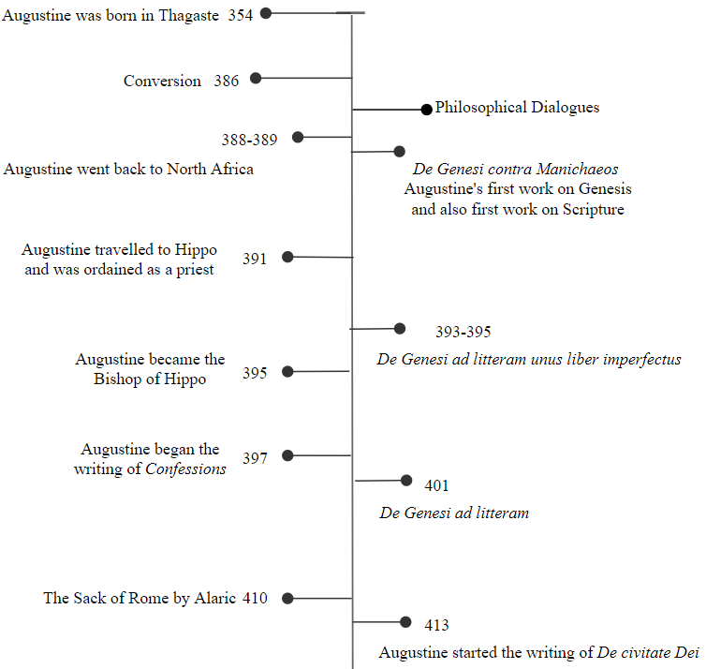
Augustine’s Five Works on Creation
De Genesi contra Manichaeos (Two Books on Genesis against the Manichees)
De Genesi ad litteram liber unus inperfectus (On the Literal Interpretation of Genesis, An Unfinished Book)
De Genesi ad litteram (libri duodecim) (The Literal Meaning of Genesis)
Book 11-13 of the Confessions
The City of God

Slide 3
Exegetical Context: The Two Creation Accounts
Genesis 1:1 – 2:3: The Six-Day Creation and the Seventh Day of Rest
Genesis 2:5 – 3:24: The Rest of Creation and the Fall
Genesis 2:4: “This is the book of the creation of Heaven and Earth; when Day was made, God made Heaven and Earth”
(Vetus Latina: Genesis, ed. Bonifatius Fischer (Freiburg: Herder, 1951), 36: “hic est liber creaturae caeli et terrae cum factus esset dies quo fecit deus caelum et terram.”)
Augustine’s comment: “between the works of God, from which He rested on the Seventh Day and those which He worked until now, Scripture inserted a certain division of its narrative.”
(Augustine, De Genesi ad litteram V. xi. 27, eds. Paul Agaësse and Aimé Solignac, Oeuvres de Saint Augustin 48-49 (Bruges-Paris: Declée de Brouwer, 1972), Vol. 1, 412: “Inter illa ergo opera Dei, a quibus requieuit in die septimo, et ista, quae usque nunc operatur, quondam scriptura interponens suae narrationis articulum commendauitse illa explicasse et coepit iam ista contexere.”)

Slide 4
Two Types of Non-Literal Interpretations
“He is rightly called by the name of that which signified Him before His coming. He is the Lamb immolated on the Passover; nevertheless, that immolation was represented not only just by words but also by a real act. For one cannot say that that lamb was not a lamb; it was truly a lamb, and it was slain, and it was eaten. And although this was something that really happened, something else was prefigured by it. This event was different from that of the fatted calf which was killed for the feast in honor of the younger son on his return home. In the latter case the narrative itself is a narrative of figures or types; it is not a matter of a figurative meaning of events that really happened.”
Augustine, De Genesi ad litteram VIII. iv. 8, Vol. 2, 22: “Recte quippe appelatur quod ad eum significandum praecessit. Ipse est ouis, quae immolatur in pascha; tamen et illud non tantum dicendo figurabatur, sed etiam faciendo. Neque enim ouis illa non erat ouis; plane ouis erat et occidebatur et manducabatur. Et tame neo uero facto aliud etiam quiddam figurabatur, non sicut ille uitulus saginatus, qui minore filio reuertente in epulas caesus est. Ibi quippe ipsa narration figurarum est, non rerum figurata significatione gestarum.” This piece of translation is from: Augustine, The Literal Meaning of Genesis, translated and annotated by John Hammond Taylor (Mahwah: Paulist Press, 1982), Vol. 2, 38-39.

Slide 5
De Genesi contra Manichaeos
Indications of the Linear Progression of Time:
Time flowing in the Week of Creation independent of any celestial movement;
The temporal nature of the “mornings” and “evenings;”
The Analogy between the Six-Day Creation and the Six Ages of the World.
“Therefore it remains that we should understand in the very space of time (mora temporis) the division of works thus called; evening because of the completion of a finished work, and morning the beginning of a future work.”
(Augustine, De Genesi contra Manichaeos. I. xiv. 20, ed. Dorothea Weber, CSEL 91 (Wien: Verlag der Österreichischen Akademie der Wissenschaften, 1998), 87-88: “Restat ergo, ut intellegamus in ipsa quidem mora temporis ipsas distinctiones operum sic appellatas: vesperam propter transactionem consummati operis et mane propter inchoationem futuri operis.”)

Slide 6
De Genesi ad litteram liber unus inperfectus
“Or was that enumeration of Days according to the habit of human frailty arranged by the rule of narrating and of insinuating the lofty things downwardly to the lowly, by which the very speech of the narrator was not able unless, to some extent, had a beginning, a middle part, and an end?”
Augustine, De Genesi ad litteram liber unus inperfectus 3 (8), ed. Joseph Zycha, in CSEL 28 (III. 2) (Vindobonae: F. Tempsky, 1894), 463: “an ista dierum digestio secundum consuetudinem humanae fragilitatis ordinata est lege narrandi et humilibus humiliter insinuandi sublimia, qua et ipse sermo narrantis non potest nisi aliqua habere et prima et media et ultima?”
“In this Book the narrative of things made by God was divided most conveniently as if through intervals of time, so that the very arrangement, which the weaker souls could not understand with firm consideration, might be discerned just as visually, when it was exposited via this order of expression.”
Augustine, De Genesi ad litteram liber unus inperfectus 7 (28), 479: “sed commodissime in hoc libro quasi per morarum interualla factarum a deo rerum digesta narratio est, ut ipsa dispositio, quae ab infirmioribus animis contemplatione stabili uideri non poterat, per huius modi ordinem sermonis exposita quasi istis oculis cerneretur.”

Slide 7
De Genesi ad litteram
The New Picture:
Firstly, Heaven and Earth and the Creation Week accounted in Genesis 1:1-2:3 were understood as creations in principles and causality, which were simultaneous and instant without temporal lapse;
Secondly, although time metaphysically started with the first creation Heaven and Earth, it began to unfold (currere) after the Week of Creation.
Two Central Philosophical Ideas:
Rationes seminales;
The Angelic Participation in Creation.

Slide 8
