Slide 1
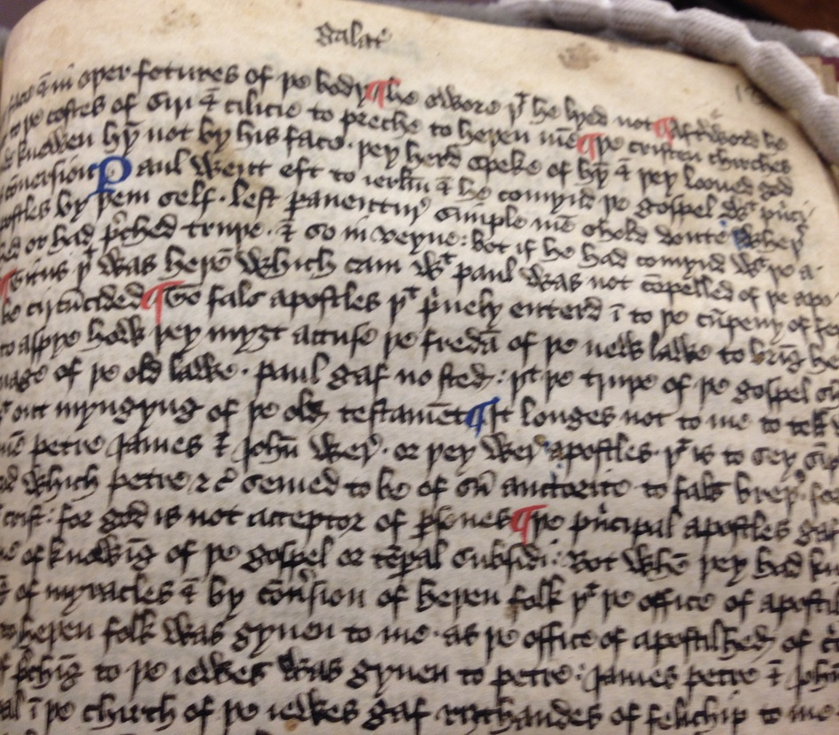
‘Into the cumpeny of feythful men’: Galatians, Authority, and The Middle English Declaracion on the Bible
Dr Hannah Schühle-Lewis
University of Kent
h.schuhle-lewis@kent.ac.uk

Slide 2
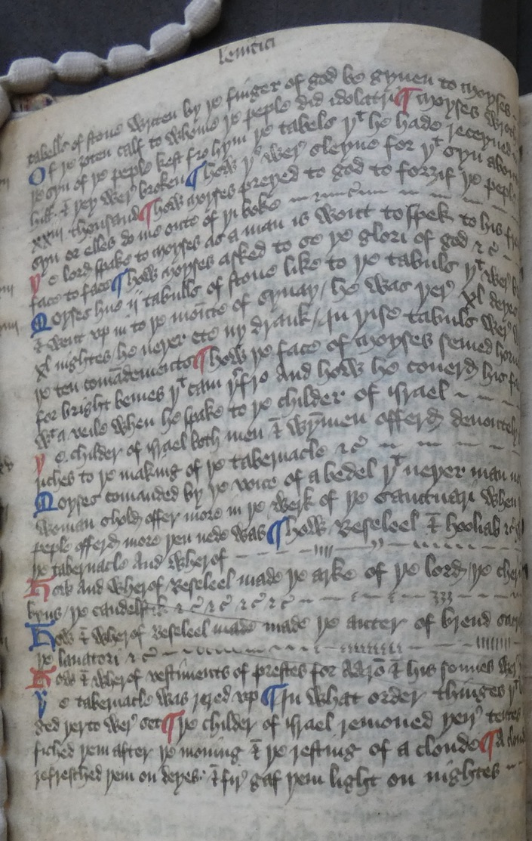
34 Moyses hue ij. tabulls of stone like to þe tabuls þat wer broken and went up in to þe mounte of Synay. He was þere xl. deyes and xl. nightes. He neþer ete ny drank. In þis tabuls were writen þe ten comandements.
How þe face of Moyses semed horned for bright bemes þat cam þerfro, and how he coverd his face with a veile when he spake to þe childer of Israel.
35 Þe childer of Israel both men and wymmen offerd devoutely gret riches to þe making of þe tabernacle, &c.
36 Moyses comanded by þe voice of a bedel þat neþer man nor woman shold offer more in þe werk of þe sanctuari, when þe peple offerd more þen nede was.
How Beseleel and Hooliab &c. wroght þe tabernacle and wherof.
37 How and wherof Beseleel made þe arke of þe Lord: þe cherubyn, þe candlestick, &c.
Exodus 34-37, fol. 4v

Slide 3
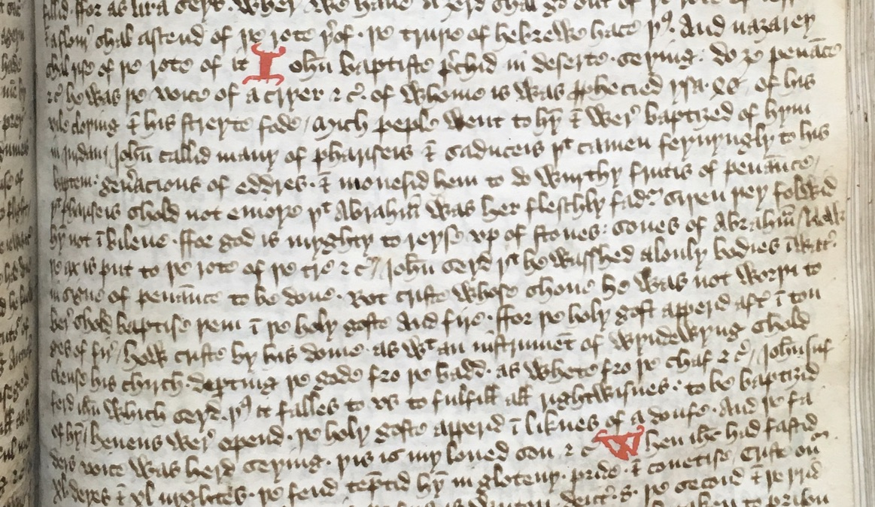
Matthew, Chapter 3 (fol. 151r.):
Iohan Baptiste prechid in deserte, seying, Do ӡe penance, &c. He was þe voice of a cryer, &c., of whome it was prophecied, Ysaie 40. Of his vile cloþing & his streyte fode. Mich peple went to hym & were baptiӡed of hym in Iurdan. Iohan callid many of Phariseis & Saduceis þat camen feynyngly to his baptem Generacions of eddres, & monesid hem to do wurthy frutis of penaunce. Þat Phariseis shold not enioye þat Abraham was her fleschly fader, siþen þey folwid hym not in bileue, ffor God is myghty to reyse vp of stones sones of Abraham. Now þe ax is put to þe rote of þe tre, &c. Iohan seyd þat he wasshed alonly bodies in water, in signe of penaunce to be done. Bot Criste, whose shone he was not worþi to bere, shold baptise þem in þe Holy Goste and fire. Ffor þe Holy Gost apperid after in tonges of fire. How Criste by his dome, as with an instrument of wyndewyng, shold clense his Chirch, departing þe gode fro þe badd, as whete fro þe chaf, &c. Iohan sufferd Iesus, which seyd, Þus it falles to vs to fulfill all rightwisnes, to be baptiӡid of hym. Heuens were opend, þe Holy Goste apperid in liknes of a doufe, and þe Fader's voice was herd, seying, Þis is my loued son, &c.

Slide 4
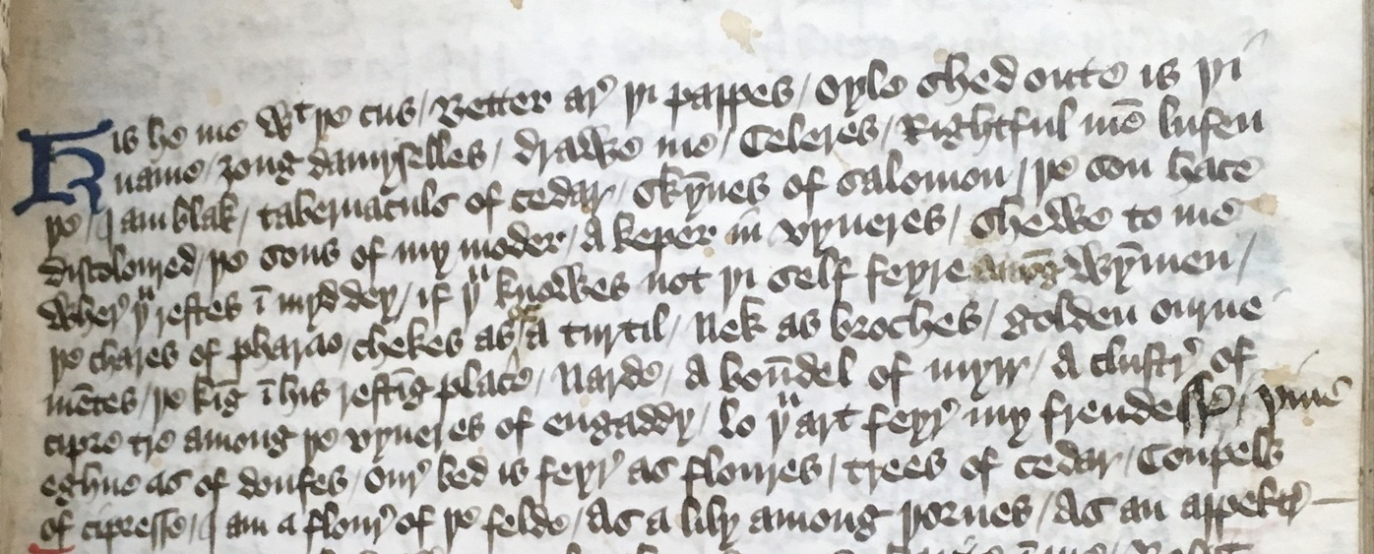
Kis he me with þe cus / Better are þi pappes / oyle shed oute is þi name / ӡong damyselles / drawe me / Celeres / Rightful men lufen þe / I am blak / tabernaculs of cedar / skynnes of Salomon / þe son hace discoloured / þe sons of my moder / a keper in vyneres / shewe to me where þou restes in myd dey / if þou knowes not þi self feyre among wymmen / þe chares of pharao / chekes as of a turtil / Nek as broches / golden ournementes / þe king in his resting place / Narde / a boundel of myrr / a cluster of cipre tre among þe vyneres of engaddy / lo þou art feyre my frendesse / þine eghne as of doufes / oure bed is feyre as floures / trees of cedar / Coupels of cipresse / I am a floure of þe felde / as a lily among þornes / as an appeltre
(Song of Songs Chapter 1, fol. 74^{r})

Slide 5
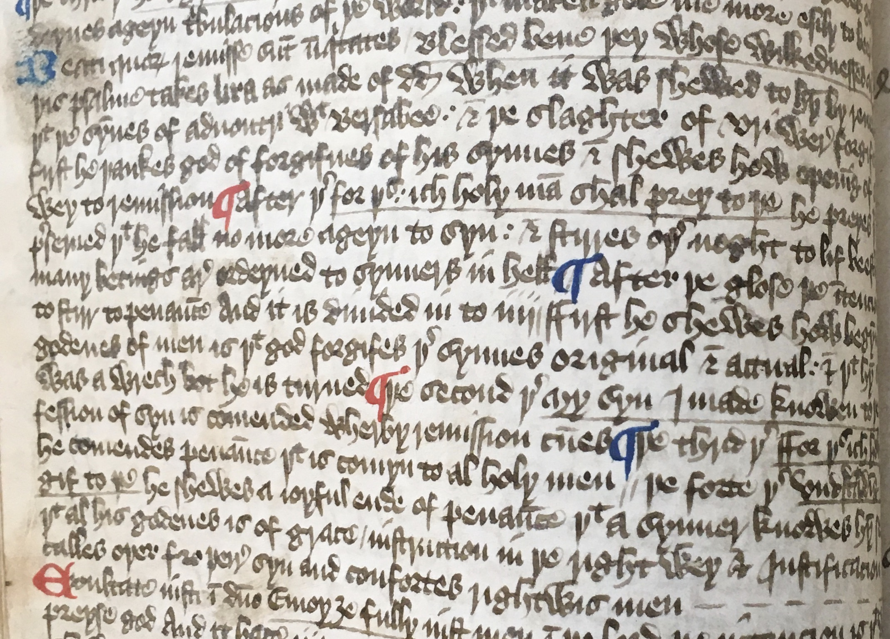
Beati quorum remisse sunt iniquitates Blessed bene þey whose wikkednesses are forgife. Þis psalme takes Lira as made of Dauid when it was shewed to hym by reuelacion þat þe synnes of aduoutri with Bersabee & þe slaghter of Vri were forgifen. & first he þankes God of forgifnes of his synnes & shewes how opening of syn is wey to remission.
After þer, for þis ich holy man shal prey to þe, he preyes þat he be preserued, þat he fall no more ageyn to syn, & stirres oþer noght to lif beestly, for many betings are ordeyned to synners in hell.
After þe glose, þe intencion is to stirr to penaunce, and it is diuided in to iiij: ffirst he shewes how begynning of godenes of men is þat God forgifes þeire synnes, original & actual; & þat hym self was a wrech, bot he is turned.
Þe second þer, My syn I made knowen to þe, confession of syn is comended, wherby remission cumes.
Psalm 31, 41v

Slide 6
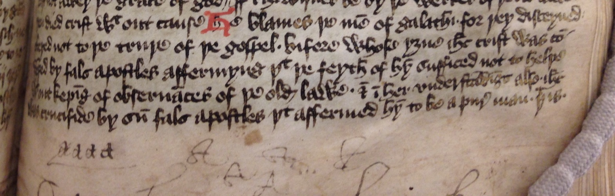
Opening to Galatians 3, 182r-v:
He blames þe men of Galathi for þey, disceyued, obeyed not to þe truþe of þe gospel, bifore whose yӡne Iesus Crist was condempned by fals apostles affermyng þat þe feyth of hym sufficed not to helþe without keping of obseruances of þe olde lawe, & in her vnderstandings also. Iesus was crucifide by sum fals apostles þat affermed hym to be a pure man, þat is alone man & not God.
He proues þat þey were foolis siþen þey receyued þe holy goste in her baptem in a sensible signe, which was not so gyuen to kepers of werkes of þe olde lawe, þat þey wold receyue ouer þis fleschly obseruaunces of þe olde lawe, and so tribulacions þat þey had sufferd for Crist shold be to hem without profit. Neþeles þey sufferd not veynly without cause if þey wolde leeue þis errour.
He þat gyues þe holy spirit in a sensible signe & wirkes myraclis among ӡu dose he þis of werkes of þe lawe, as who sey ney, bot of feyth. Þis he confermes by scripture, Genesis 15, Abraham bileued to God, &c.
Þey þat bileuen to be iustified by þe feyth of Crist are þe sones of Abraham, he shewes by scripture Genesis 22 þat þe blessing of God is not of Moyses lawe, bot of þe feyth of Crist, &c.

Slide 7
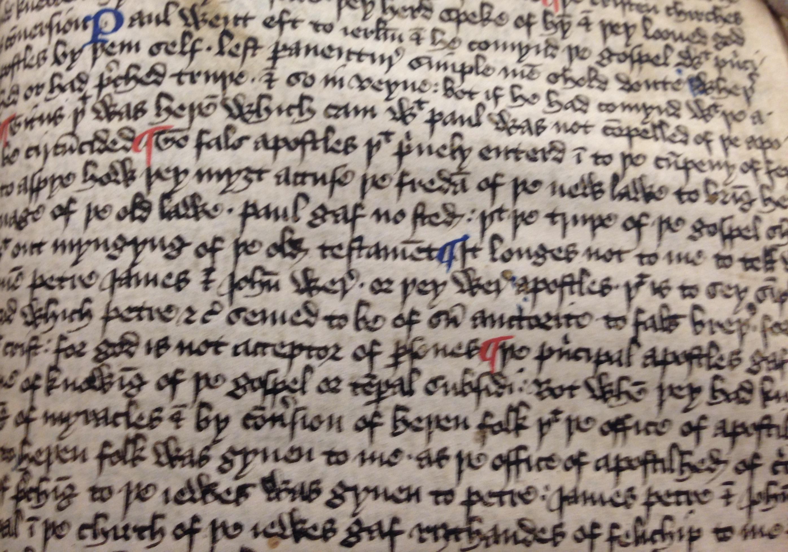
Galatians 2, fol. 182r:
2 Paul went eft to Ierusalem & he comynd þe gospel with principal apostles by þemself, lest perauenture simple men shold doute wheþer he preched or had preched truþe, & so in veyne, bot if he had comynd with þe apostles.
[…]
To fals apostles þat priuely enterd into þe cumpeny of feythful men to aspye how þey myӡt accuse þe fredam of þe new lawe to bring hem into seruage of þe old lawe, Paul gaf no stede. Þat þe truþe of þe gospel shold duell without myngyng of þe olde testament.
It longes not to me to tell what manere men Petre, James & Johan were or þey were apostles, þat is to sey simple & vnlettred, which Petre, &c., semed to be of sum auctorite to fals breþer, for þey went with Crist, for God is not acceptor or persones.
Þe principal apostles gaf no þing to me of knowing of þe gospel or temporal subsidi. Bot when þey had knowen by wirking of myracles & by conuersion of heþen folk þat þe office of apostilhed to preche to heþen folk was gyuen to me as þe office of apostilhed of circumcision, þat is of preching to þe Iewes, was gyuen to Petre, James, Petre & Johan þat were principal in þe chirch of þe Iewes gaf riӡthandes of felichip to me & to Barnabas […]

Slide 8
How Paul ageynstode Petre, repreuyng hym openly by cause þat or Iewes cam fro James bischop of Ierusalem, he lyued heþenly, þat is, he ete with heþen men not abstenyng fro meetis forbed in þe old lawe bot when þey cam he withdrewe hym fro such meetis, &c., and so sum heþen men by ensaumple of hym wend þat keping of obseruances of þe old lawe had ben nedeful to gostly helþe, þat is ageyn þe truþe of þe gospel.
Galatians 2, 182r

