Slide 1
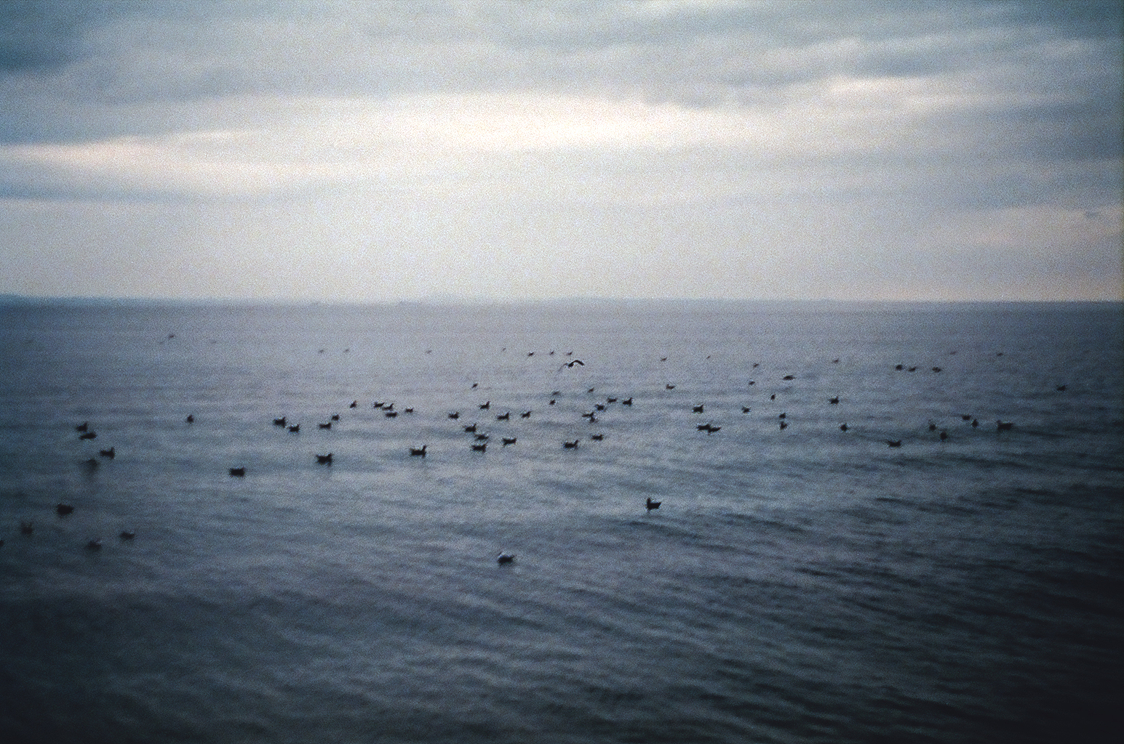

Intertextuality and Suffering in
Andreas saga postola I
  Eugenia K. Vorobeva
  eugenia.vorobeva@jesus.ox.ac.uk
  Jesus College, Oxford

Slide 2
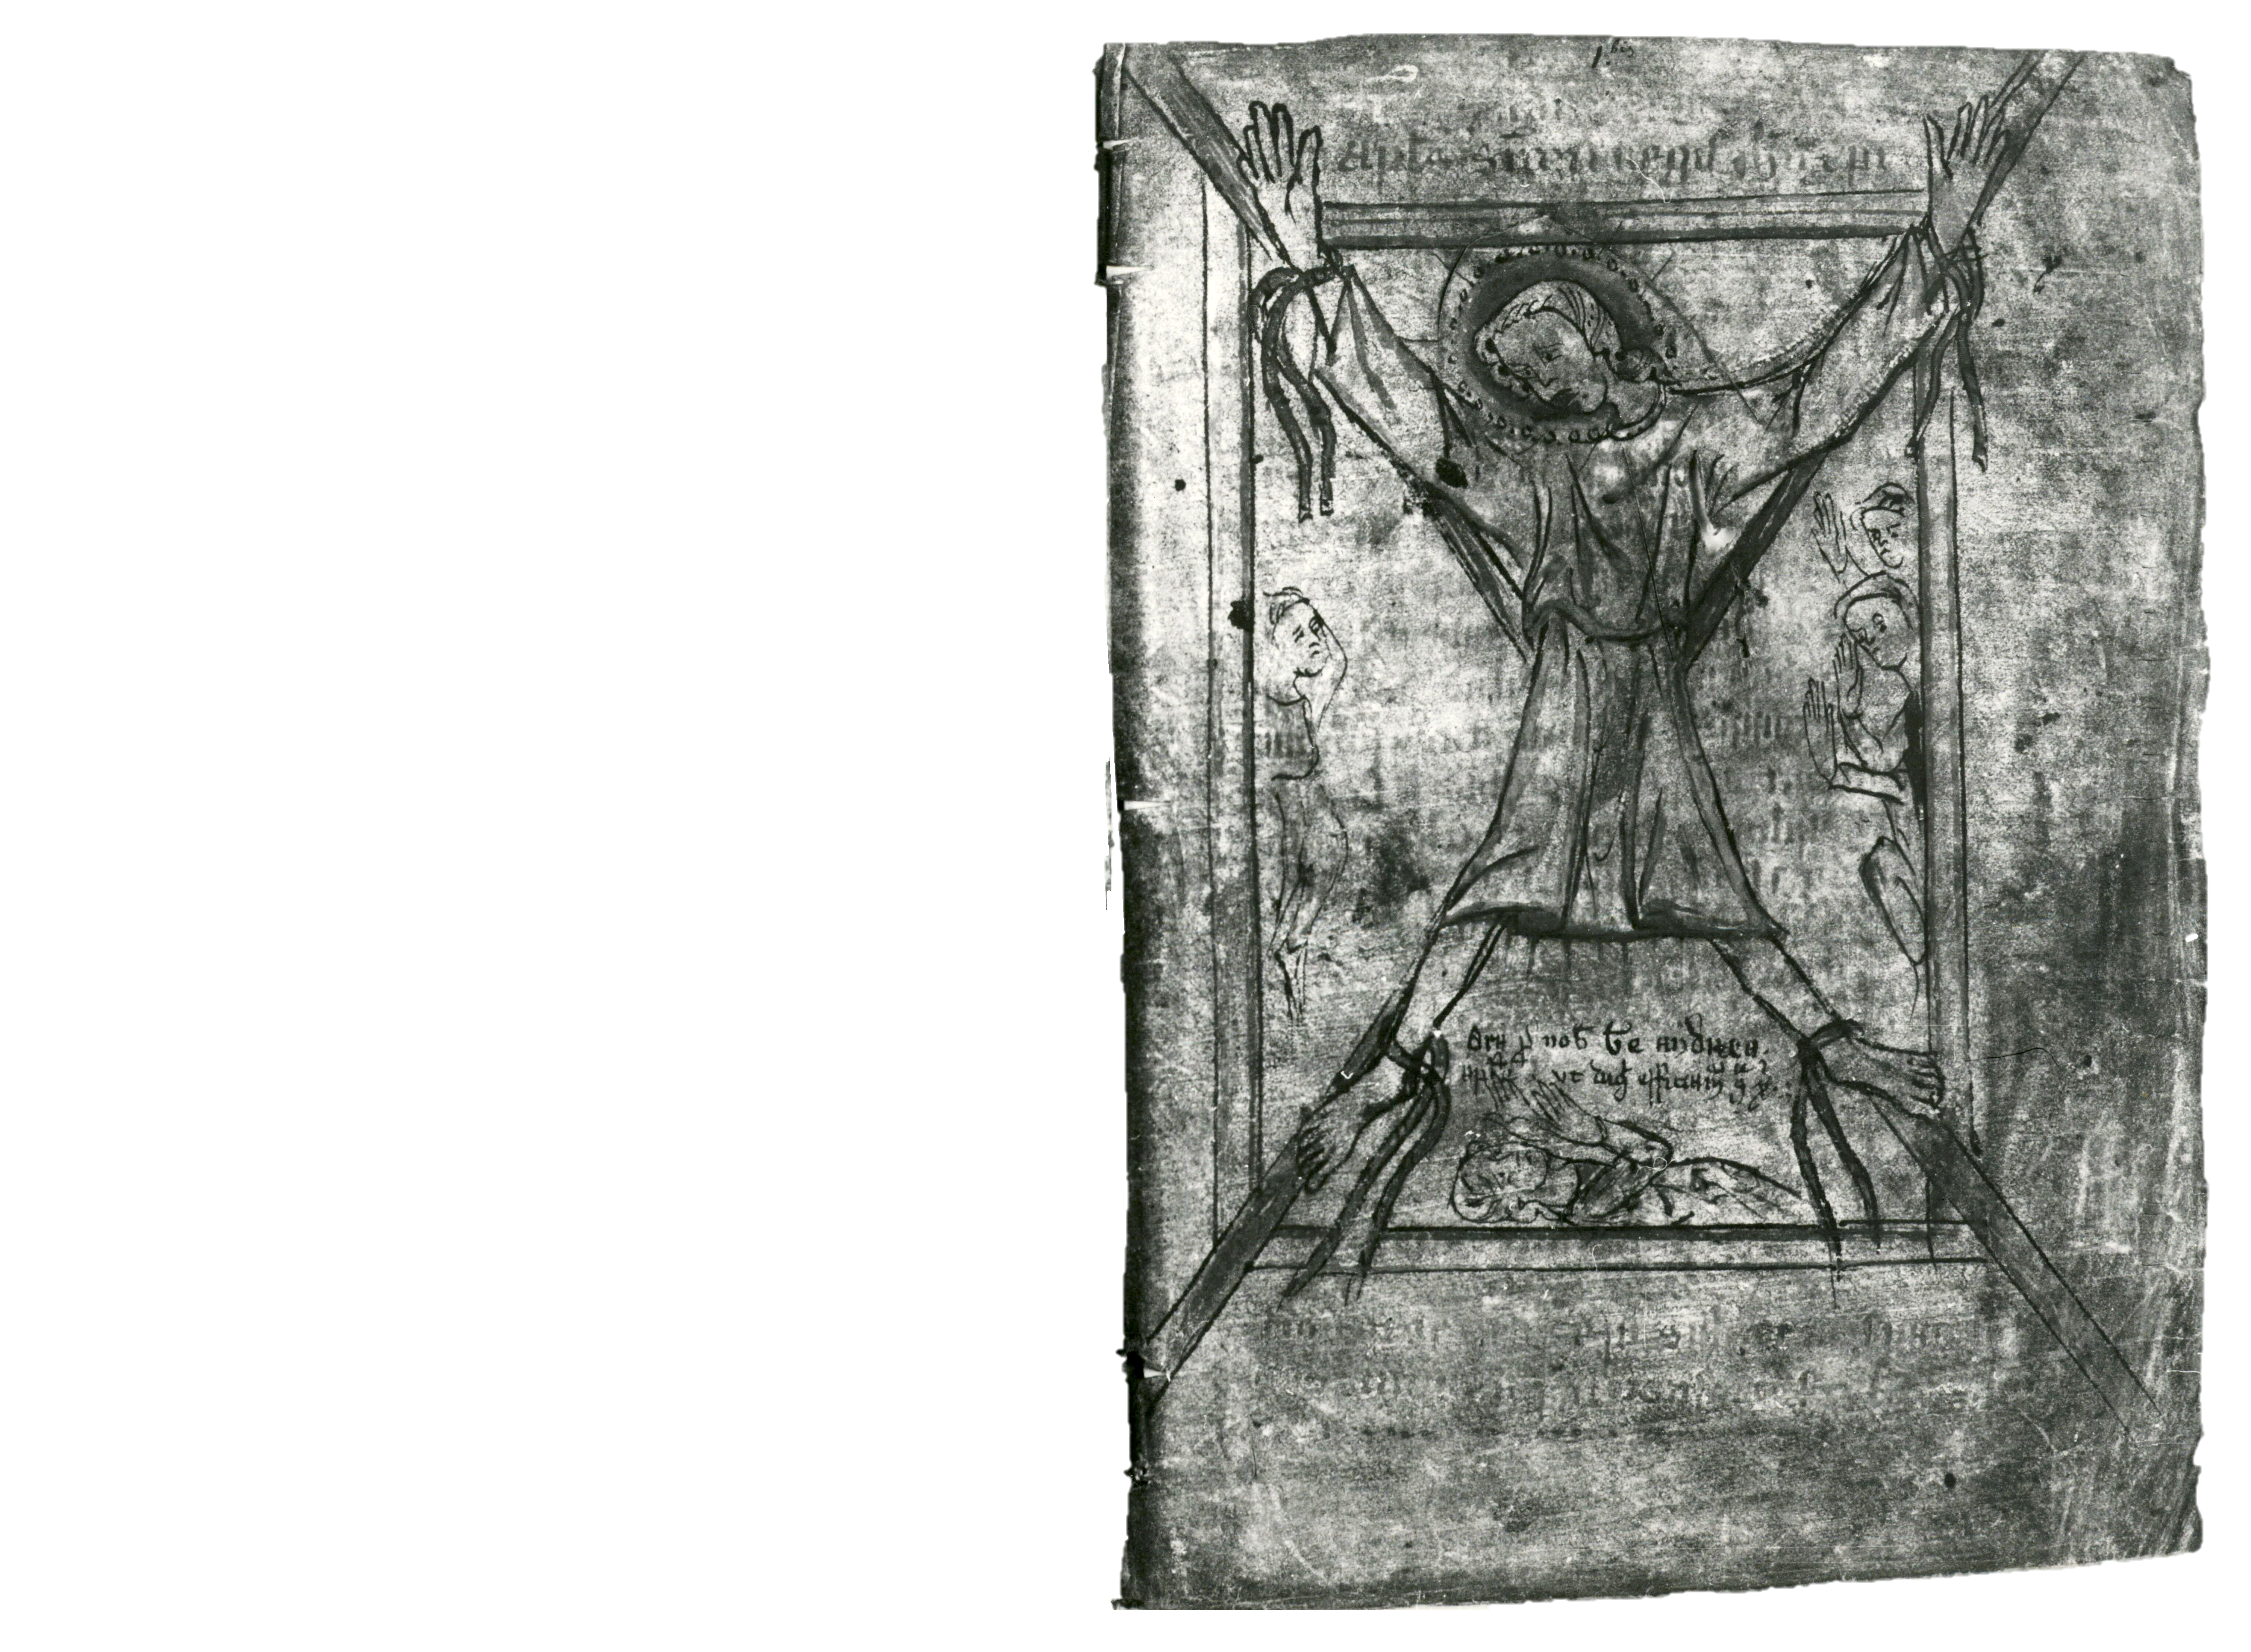
Andréss saga postula (Andr²A),
in AM 646 4º, fol. 4r

Slide 3
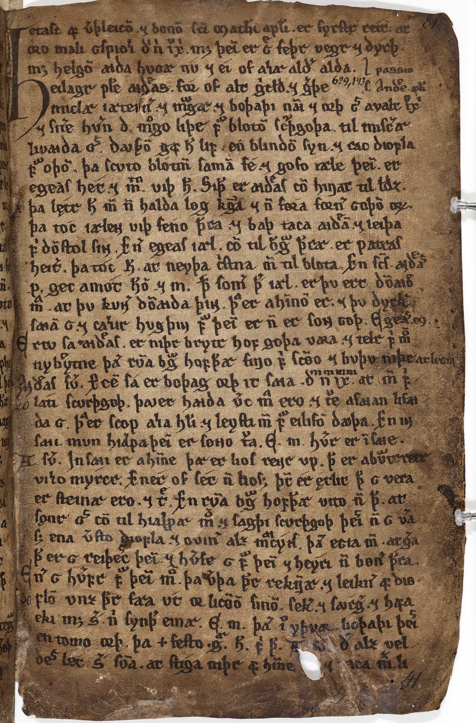
MANUSCRIPTS & PROVENANCE
HEILAGRAMANNA SÖGUR
Iceland, 1200-1249
AM 645 4to
POSTOLA SÖGUR
Iceland, 1600-1699
AM 652/630 4to
AM 645 4to, f.41r

Slide 4
STRUCTURE & SOURCES
Prologue
The vita section:
Andrew and Mathew in Mirmidon
Andrew cures a blind man
Andrew rescues Sostratus from the incestuous urges of his mother
Andrew cures a family of uncleanliness
Andrew expels seven demons from Nicea
Andrew calms both a storm at sea and a troop of belligerent soldiers
Andrew prevents an incestuous union and preaches at sea
Andrew converts and protects a noble youth
Andrew cures a sick boy
Andrew resurrects a boy
Andrew makes Medias free captives and cures his son
Andrew cures an Egyptian boy
Andrew cures a boy killed by demons
Andrew resurrects forty drowned youths
The transition from vita to passio:
The miracle of the cure of Proconsul Egeas’ sick wife Maximilla
The passio section:
Andrew's interrogation by Egeas
Andrew’s martyrdom and burial
The miracle of the manna and oil at Andrew’s tomb
De gestis beati Andreae Apostoli,
in Pseudo-Abdias, Historica Apostolica , III
Passio Sancti Andreae Apostoli

Slide 5
En er Andreas postoli sa Mattheum postola þar inni með oðrum bandingium, þeim er þeir borgarmenn hofðu i pislum fyrir guðs nafni, þa gret hann beiskliga ok bað til guðs ok mælti: „[…].“ En þegar er hann hafði lokit bøn sinni, þa skalf myrkvastofan, ok þvi næst skein lios mikit i myrkvastofuna af himni. Þa tok Mattheus postoli sion sina, ok fellu af honum iarnrekendrnar, er hann var bundinn með, ok allir þeir er bundnir voru, slitnuðu bondin af þeim, ok urðu þeir lausir, ok lofuðu allir guð ok mælltu: „Mikill er guð, sa er helgir postolar boða.“ Siðan leiddi Andreas postoli þa menn alla or myrkvastofunni, ok let hvern fara til sins heraðs. Þa varð fagnaðarfundr mikill með þeim postolum, [...].
“And when Andrew the apostle saw Matthew the apostle therein with other captives, those who endured tortures for the name of god, then he wept bitterly, and called out to god, and said: “[…].” And as soon as he finished his prayer, the prison trembled, and then, next, a great light from heaven shone in the prison. Then Matthew the apostle recovered his sight, and the iron fetters with which he was bound fell from him, and all those who were bound broke free from their bonds, and they became free, and all praised god and said: “Great is god, whom the saintly apostles preach.” Then Andrew the apostle led all those men out of the prison and bade each of them go to their provinces. Then there was a great joyful-meeting between the apostles, […]”.

Slide 6
De gestis beati Andreae Apostoli
Quam ut ingressus est, ad publicum illico carcerem contulit, inveniensque cum r(e)liquis vinctis Matthæum, amarissime flevit & facta oratione hæc ve(r)ba locutus est: [...].
De gestis beati Andreae Apostoli, p. 458. “Shortly after he arrived, he went immediately to a public prison, and upon finding Matthew with the rest of the captives, he wept bitterly and making a prayer he said these words:[...].”
En er Andreas postoli sa Mattheum postola þar inni með oðrum bandingium, þeim er þeir borgarmenn hofðu i pislum fyrir guðs nafni, þa gret hann beiskliga ok bað til guðs ok mælti [...].
Postola sögur, p. 320. “And when Andrew the apostle saw therein the apostle Matthew with other captives, whom the men of the city had tortured/tormented for the name of God, then he wept bitterly and prayed to god and said: [...].”

Slide 7
Tveggja postula saga Pétrs ok Páls
“[…] oc hann geck ut oc grét beiskliga. Su iðrun var sva þæg guði, at […]”
[…] and he went outside and wept bitterly. His repentance was so agreeable to God that […].

Slide 8
Óláfs saga Tryggvasonar / Flóvents saga
„Gret hon beiscliga þui at henni var mikill harmr queycðr ihiarta. Sua at hon matti huarki eta ne drecka. /Þat er sagt at Þyri drottneng kunni illa skaða sínom oc gret bæisklega frafall O. konongs. sua var mikill ryglæiki i hennar hiarta at huarki matti hon eta ne drecka.“
[She wept bitterly because to there was great grief kindled in her heart. Such that she could neither eat nor drink. /It is said that queen Þyri tolerated poorly her harmful loss and wept bitterly for the death of king Óláfr, so great was grief in her heart that she could neither eat nor drink.]
Oddr Snorrason Munk, Óláfs saga Tryggvasonar, ed. Finnur Jónsson (Copenhagen, 1932), pp. 237, 257.
“En er hvn hafði męllt við miclvm harmi, þa grę́t hvn beískliga ok reíf af ser cleði.”
[And when she had said that with much grief, then she wept bitterly and tore her clothes.]
Flóvents saga I, in Fornsögur Suðrlanda : Magus saga jarls / Konraðs saga / Bærings saga / Flovents saga / Bevers saga, ed. Gustaf Cederschiöld (Lund, 1884), p. 147.

Slide 9
Helgakviða Hundingsbana II
45. „Ein veldr þú, Sigrún / frá Sefafiǫllum, / er Helgi er / harmdǫgg sleginn. / Grætr þú, gullvarið, / grimmum tárum, / sólbiǫrt, suðrœn, / áðr þú sofa gangir; / hvert fellr blóðugt / á brjóst grami, / úrsvalt, innfjálgt, / ekka þrungit.
[‘You alone, Sigrun from Sefafell, cause Helgi to be soaked in sorrow-dew; you weep, gold-adorned lady, bitter tears, sun-bright southern girl, before you go to sleep; each falls bloody on the breast of the prince, cold and wet, burning into me, thick with grief.’]
43.„Nú em ek svá fegin / fundi okkrum /sem átfrekir /Óðins haukar, /er val vitu, /varmar bráðir, /eða dǫgglitir /dagsbrún sjá.
[‘Now I am so glad, at our meeting, as are the greedy hawks of Odin when they know of slaughter, steaming flesh, or, dew-gleaming, they see the dawn.’]
Helgakviða Hundingsbana II, in Eddukvæði II, ÍF, eds. Jónas Kristjánsson, Vésteinn Ólason (Reykjavík: Hið Íslenska Fornritafélag, 2014), p. 281.
Translation is quoted from Mills, ‘Gender and Death’, pp. 126-7.

Slide 10
Sonatorrek
2. Esa auðþeystr,
þvít ekki veldr
hǫfugligr,
ór hyggju stað
    fagnafundr
    Friggjar niðja,
    ár borinn
    ór Jǫtunheimum.
[The joyful find of the kinsmen of Frigg , brought long ago from the world of giants, is not easily driven from the home of thought, and cruel grief causes this.]
Egils saga Skalla-Grímssonar, ÍF II, ed. Sigurður Nordal (Reykjavík: Hið Íslenska Fornritafélag, 1933), p. 247. Translation is cited from E.O.G. Turville-Petre, Scaldic Poetry (Oxford: Clarendon Press, 1976), p. 29. Also, see Inna Matyushina’s more literal translation of this stanza in her article ‘Grief, Gender, and the Birth of Lyric in Old Norse Poetry’, in Grief, Gender, and Identity in the Middle Ages: Knowing Sorrow, ed. Lee Templeton (Brill, 2022), pp. 94-117 (p. 113): “It is not easy to emit (to breathe out), as the sobbing [italics is mine – E.V.] presses hard out of the dwelling of thought (=breast) a joyful gift of the descendants of Frigg (=asir), delivered in ancient times from Jǫtunheimr.”

Slide 11
En er Andreas postoli sa Mattheum postola þar inni með oðrum bandingium, þeim er þeir borgarmenn hofðu i pislum fyrir guðs nafni, þa gret hann beiskliga ok bað til guðs ok mælti: „[…].“ En þegar er hann hafði lokit bøn sinni, þa skalf myrkvastofan, ok þvi næst skein lios mikit i myrkvastofuna af himni. Þa tok Mattheus postoli sion sina, ok fellu af honum iarnrekendrnar, er hann var bundinn með, ok allir þeir er bundnir voru, slitnuðu bondin af þeim, ok urðu þeir lausir, ok lofuðu allir guð ok mælltu: „Mikill er guð, sa er helgir postolar boða.“ Siðan leiddi Andreas postoli þa menn alla or myrkvastofunni, ok let hvern fara til sins heraðs. Þa varð fagnaðarfundr mikill með þeim postolum, [...].
“And when Andrew the apostle saw Matthew the apostle therein with other captives, those who endured tortures for the name of god, then he wept bitterly, and called out to god, and said: “[…].” And as soon as he finished his prayer, the prison trembled, and then, next, a great light from heaven shone in the prison. Then Matthew the apostle recovered his sight, and the iron fetters with which he was bound fell from him, and all those who were bound broke free from their bonds, and they became free, and all praised god and said: “Great is god, whom the saintly apostles preach.” Then Andrew the apostle led all those men out of the prison and bade each of them go to their provinces. Then there was a great joyful-meeting between the apostles, […]”.

Slide 12
Luke 19:41-47
“Et ut appropinquavit, videns civitatem flevit super illam, dicens:[…].”
And as he approached, seeing the city he wept about it, saying: […].
Quam ut ingressus est, ad publicum illico carcerem contulit, inveniensque cum r(e)liquis vinctis Matthæum, amarissime flevit & facta oratione hæc ve(r)ba locutus est: [...].
Vulg Lucas 19:40-46: “ ⁴⁰ Quibus ipse ait: Dico vobis, quia si hi tacuerint, lapides clamabunt. ⁴¹ Et ut appropinquavit, videns civitatem flevit super illam, dicens: ⁴² Quia si cognovisses et tu, et quidem in hac die tua, quæ ad pacem tibi: nunc autem abscondita sunt ab oculis tuis. ⁴³ Quia venient dies in te: et circumdabunt te inimici tui vallo, et circumdabunt te: et coangustabunt te undique: ⁴⁴ et ad terram prosternent te, et filios tuos, qui in te sunt, et non relinquent in te lapidem super lapidem: eo quod non cognoveris tempus visitationis tuæ. ⁴⁵ Et ingressus in templum, cœpit ejicere vendentes in illo, et ementes, ⁴⁶ dicens illis: Scriptum est: Quia domus mea domus orationis est: vos autem fecistis illam speluncam latronum.”

Slide 13
Gregory the Great’s Homily 39
on the Gospels, on Luke 19:41-47
So he weeps over people who do not know why they should be crying because, according to Solomon's own words, "they rejoice to do evil and indulge in the worst deeds". If they knew the damnation that threatens them, they would mingle their tears with those of the elect to cry over themselves.
Postolinn let eigi at helldr af kenning sinni, sa er fullr var af miskunn heilags anda, ok bað fyrir þeim overðum, at guð gæfi þeim rettsyni till sinnar miskunnar, ok mællti: „Drottinn minn Jesus Kristr, luk upp þu hiartans augum þessarra manna með þinni miskunnar hendi, sva at þeir snuiz fra villu sinni, þviat þeir vita eigi, hvat þeir gera.“
The apostle did not let go of his teaching, who was full of the holy spirit’s mercy, and prayed for the unworthy, so that God would give them clear sight of his mercy, and said: “My Lord Jesus Christ, open up the heart’s eyes of these men with your hand of mercy so that they turn away from their heresy because they do not know what they are doing.”

Slide 14
As soon as Matthew was gone away, Andrew the apostle began preaching the teachings openly in that town. And as soon as the townsfolk heard his preaching, they were incited by devil’s power to put God’s teachings to shame, when at once they captured Andrew the apostle and dragged him around the town by the hair so hard that his blood was seen on every stone and street. The apostle did not let go of his teaching, who was full of the holy spirit’s mercy, and prayed for the unworthy, so that God would give them clear sight of his mercy, and said: “My Lord Jesus Christ, open up the heart’s eyes of these men with your hand of mercy so that they turn away from their heresy because they do not know what they are doing.” By the prayers of the apostle and his merits through God’s grace the glory of the apostle became of such great worth that he was the greatest teacher and the merriest of men when they tortured him most; and it happened at last through God’s mercy that they let him loose at once and said: “We have transgressed against you, forgive us our misdeeds and show us the path of salvation, so the wrath of God does not descend upon this city.” And when they heard this speech, then they fell to the apostle’s feet. But he raised them up and preached to them about our Lord Jesus Christ and the miracles that he performed on this earth, and how he redeemed the world with his blood. And the townsfolk took to the true faith and got baptized in the name of the father, and of the son, and of the holy spirit, receiving forgiveness of their sins, and they all praised God and the holy apostle Andrew

Slide 15
John 11:35
“Et lacrimatus est Jesus.”
[...] ok þa er hann kom þar, þa var a myrkvastofunni varðhalld mikit, ok var hon læst ramliga. En er Andreas postoli kom at myrkvastofunni, þa spruttu þegar fra lasarnir, ok skein lios solu biartara fyrir honum i myrkvastofuna.
[...] and when he came there, there was a heavy guard at the prison, and it was heavily locked. But when apostle Andrew came to the prison, then immediately the locks sprang open, and in front of him into the prison shone the light brighter than the sun.

Slide 16
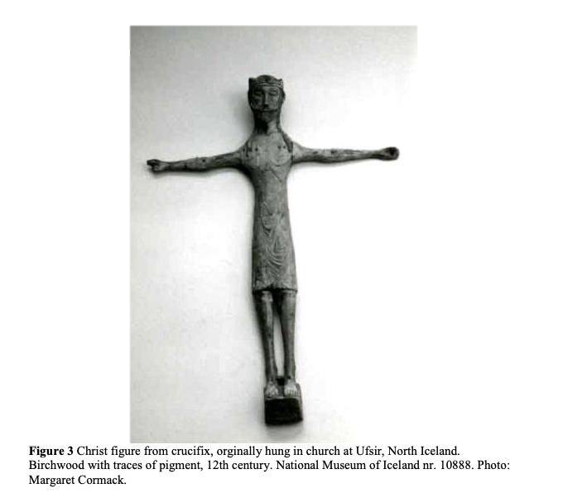
Margaret Cormack, ‘Saints of Medieval Hólar: A Statistical Survey of the Veneration of Saints in the Diocese’, Peregrinations: Journal of Medieval Art and Architecture 3.2, (2011), 7-37 (22)
THANK YOU!
@ninya_vey

