Slide 1
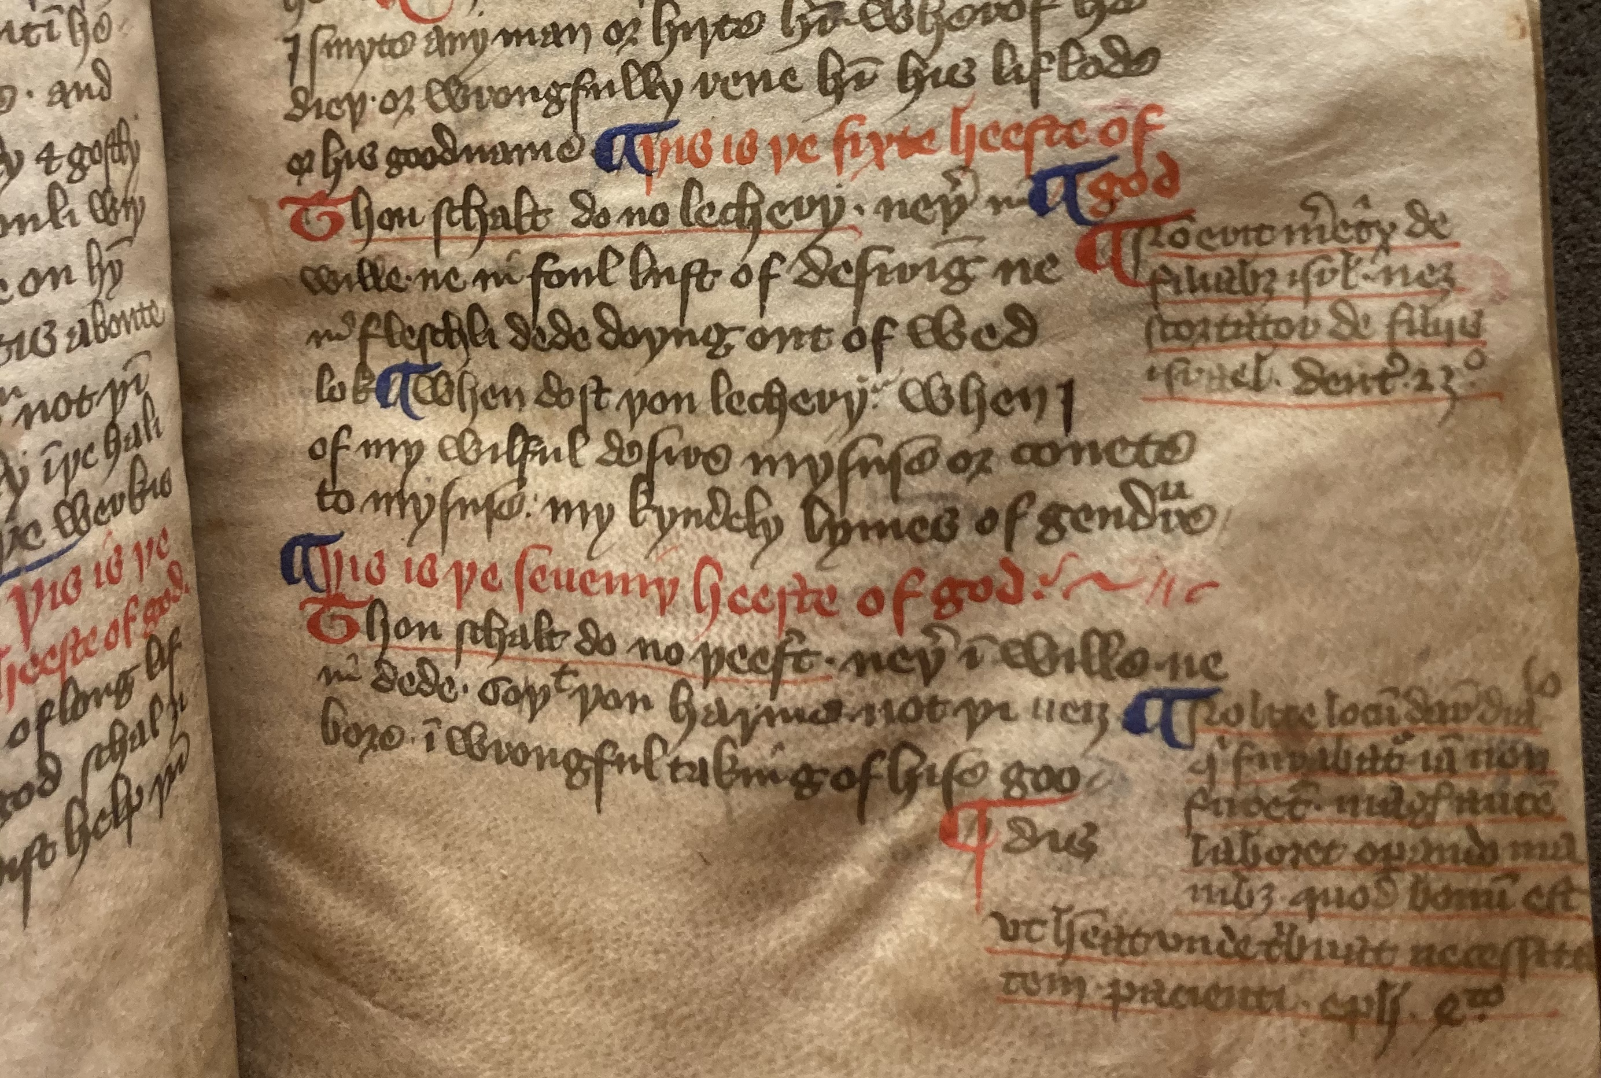
Authority in the Margins
The Glossed Catechetical Tracts of MS Bodley 938 and Wycliffite Exegetical Thought
Alexandra Barnes
alexandra.barnes@linacre.ox.ac.uk

Slide 2
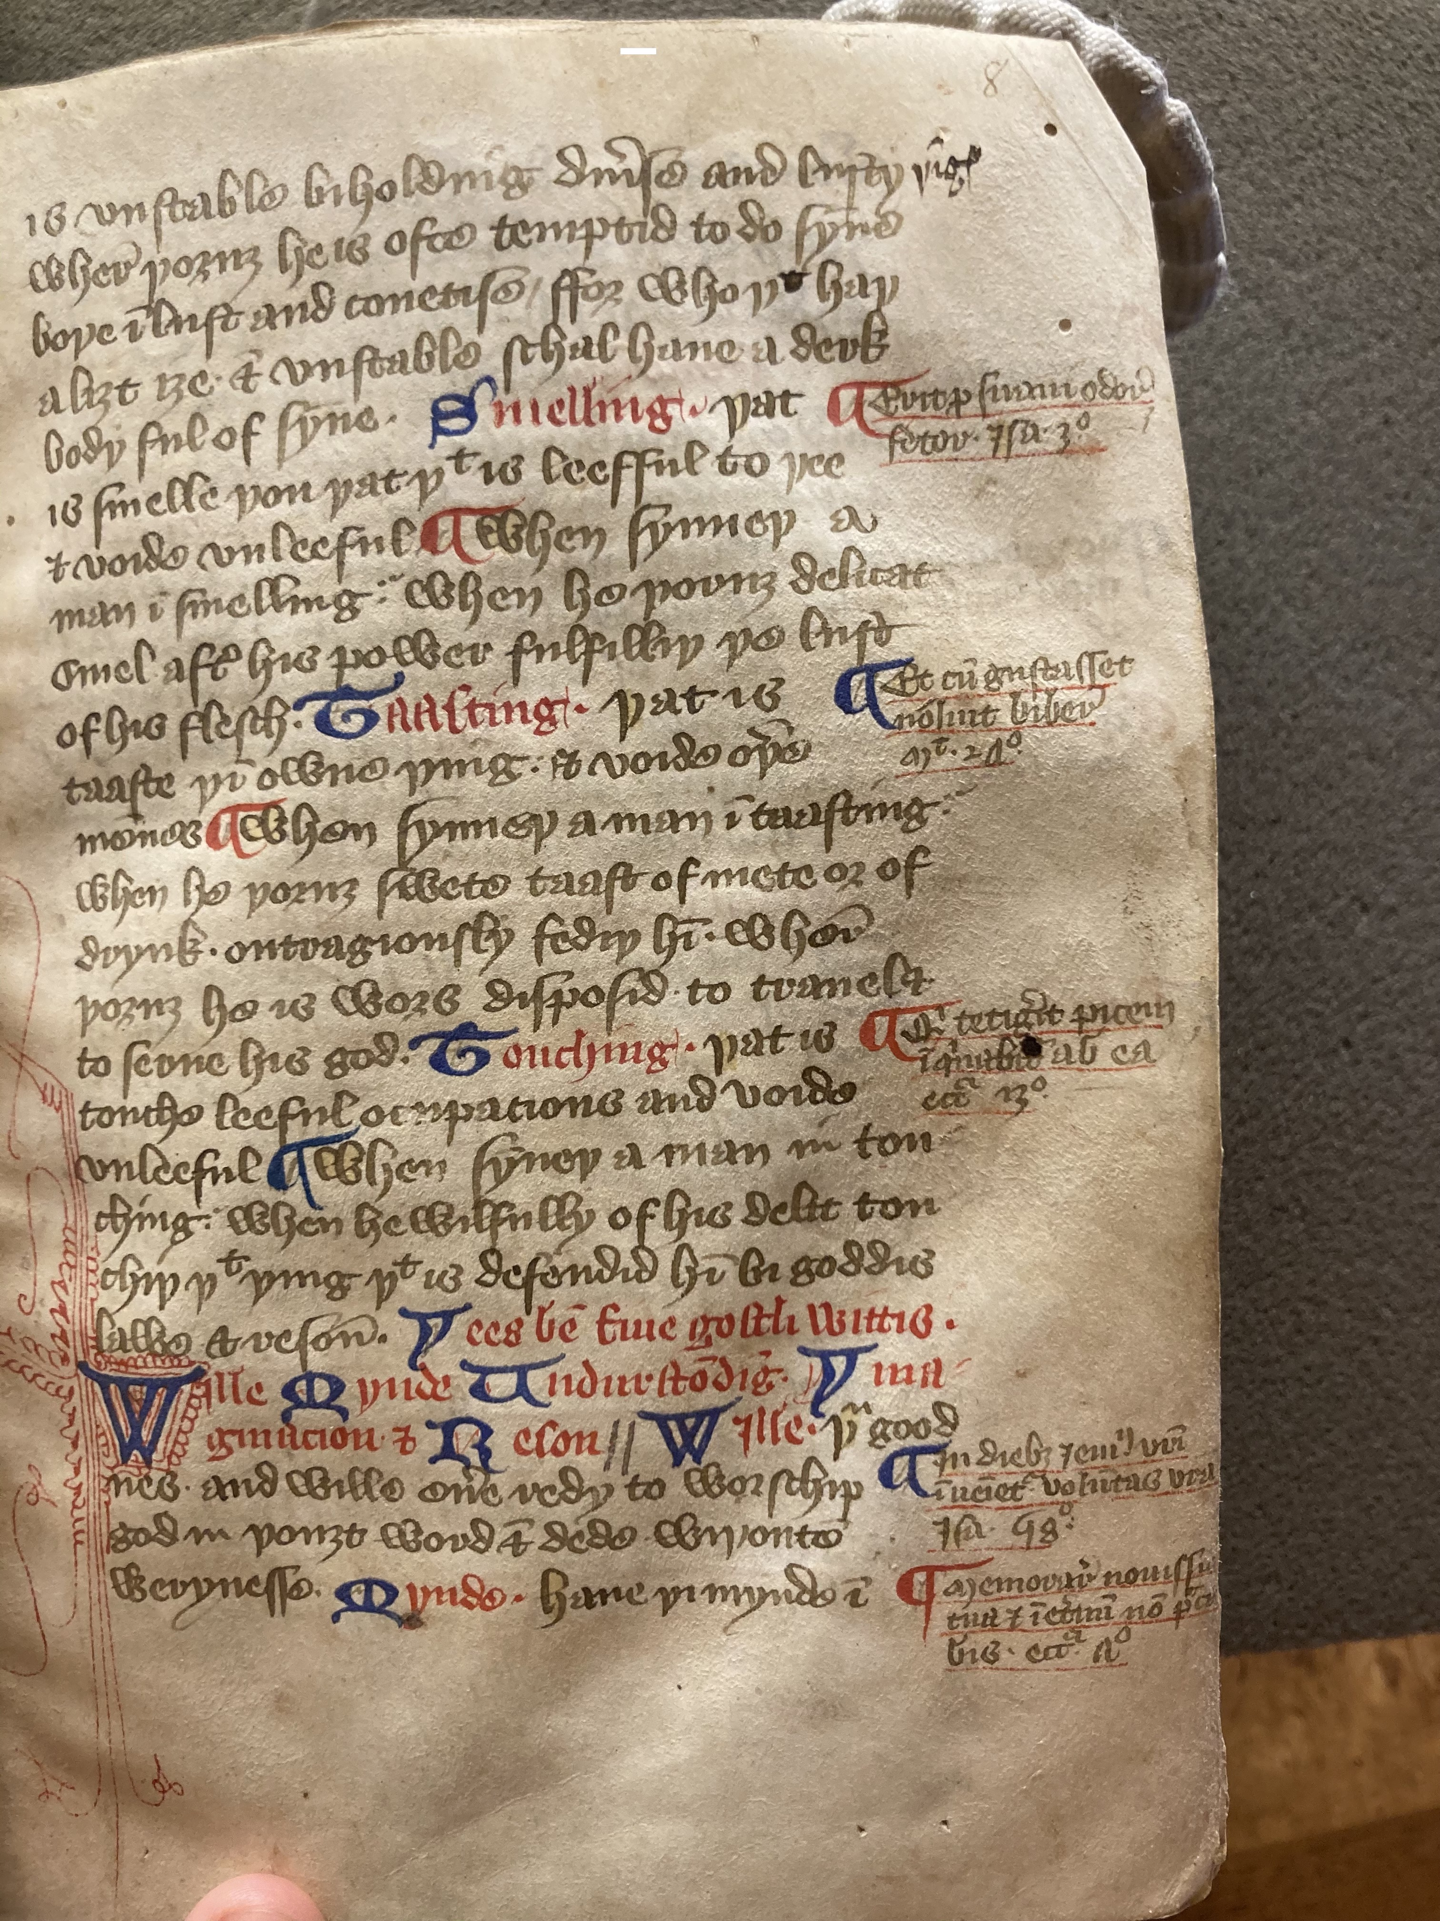
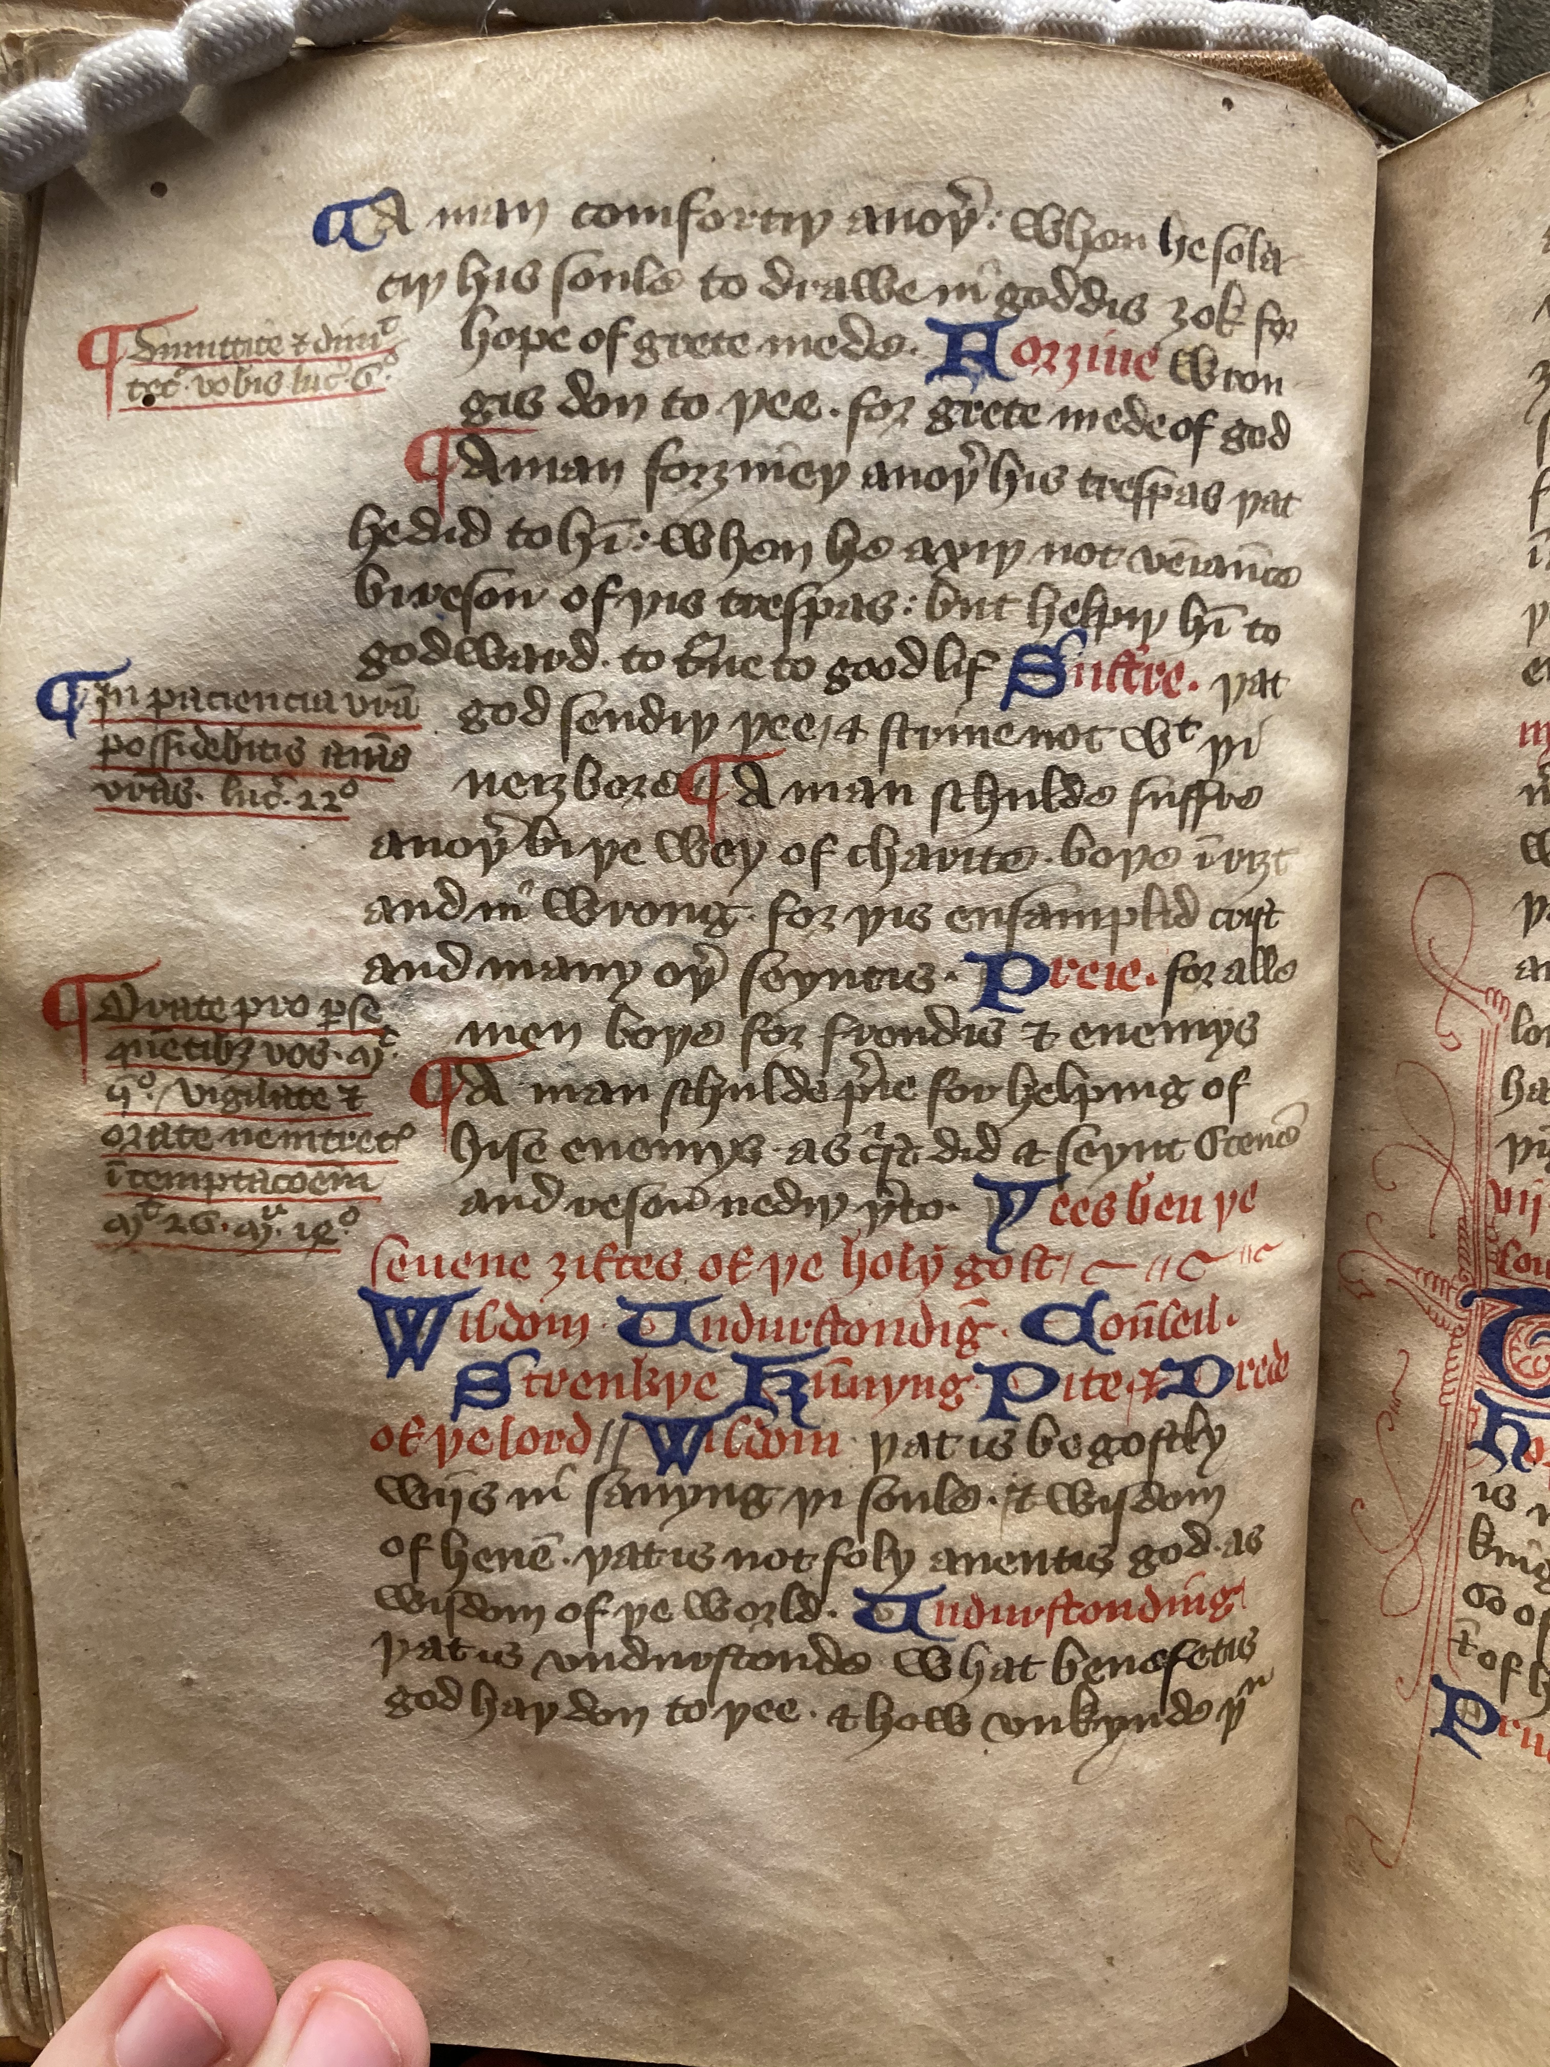
MS Bodley 938,
f. 6v ‘the Seven Works of Ghostly Mercy’ and beginning of ‘the Seven Gifts of the Holy Ghost’
f. 8r ‘the Five Bodily Wits’ and beginning of ‘the Five Ghostly Wits’

Slide 3
The Bodley 938 scribe was responsible for copying a section of Cambridge UL, MS Ff.iv.31 (John Colop’s ’common profit’ book)
Colop was appointed by John Carpenter, executor to the Mayor of London, Richard Whittington, to assist with the distribution of Whittington’s bequests (see Scase, 1992)
Bodley 938 also bears a similar scheme of (late-medieval) non-scribal annotations to the Colop ‘common-profit’ book and to London, BL MS Harley 993. Harley 993 bears a common-profit inscription stating it was financed by the goods of a ‘robert holond’ likely the shearman Robert Holland with connections to Colop.

Slide 4
MS Bodley 938,
f. 6v ‘the Seven Works of Ghostly Mercy’ and beginning of ‘the Seven Gifts of the Holy Ghost’
f. 8r ‘the Five Bodily Wits’ and beginning of ‘the Five Ghostly Wits’

Slide 5
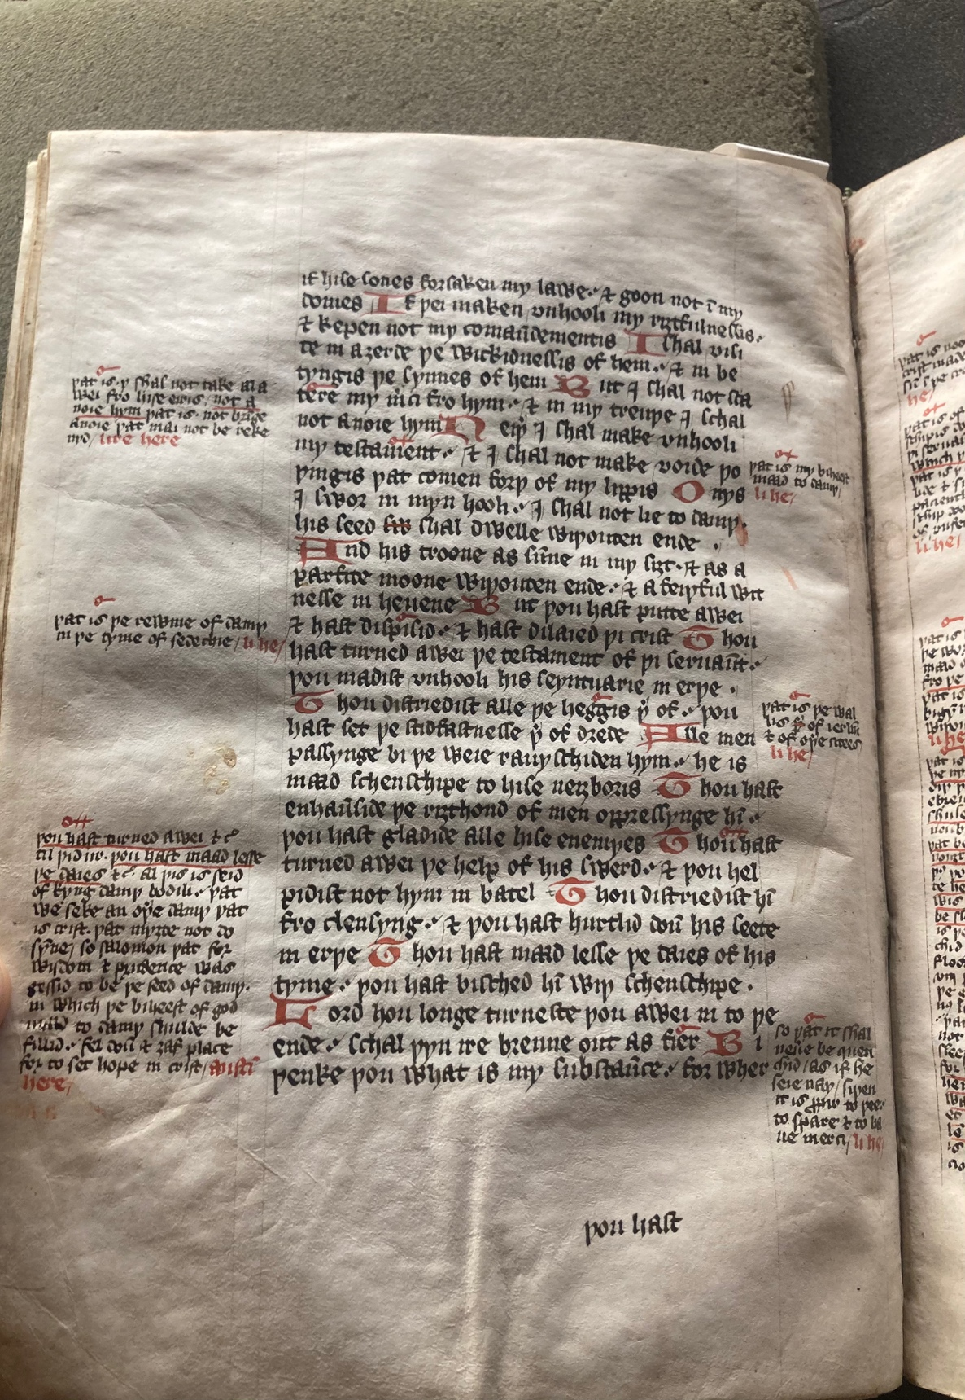
Oxford, Bodleian Library MS Bodley 554, f. 49^{v}

Slide 6
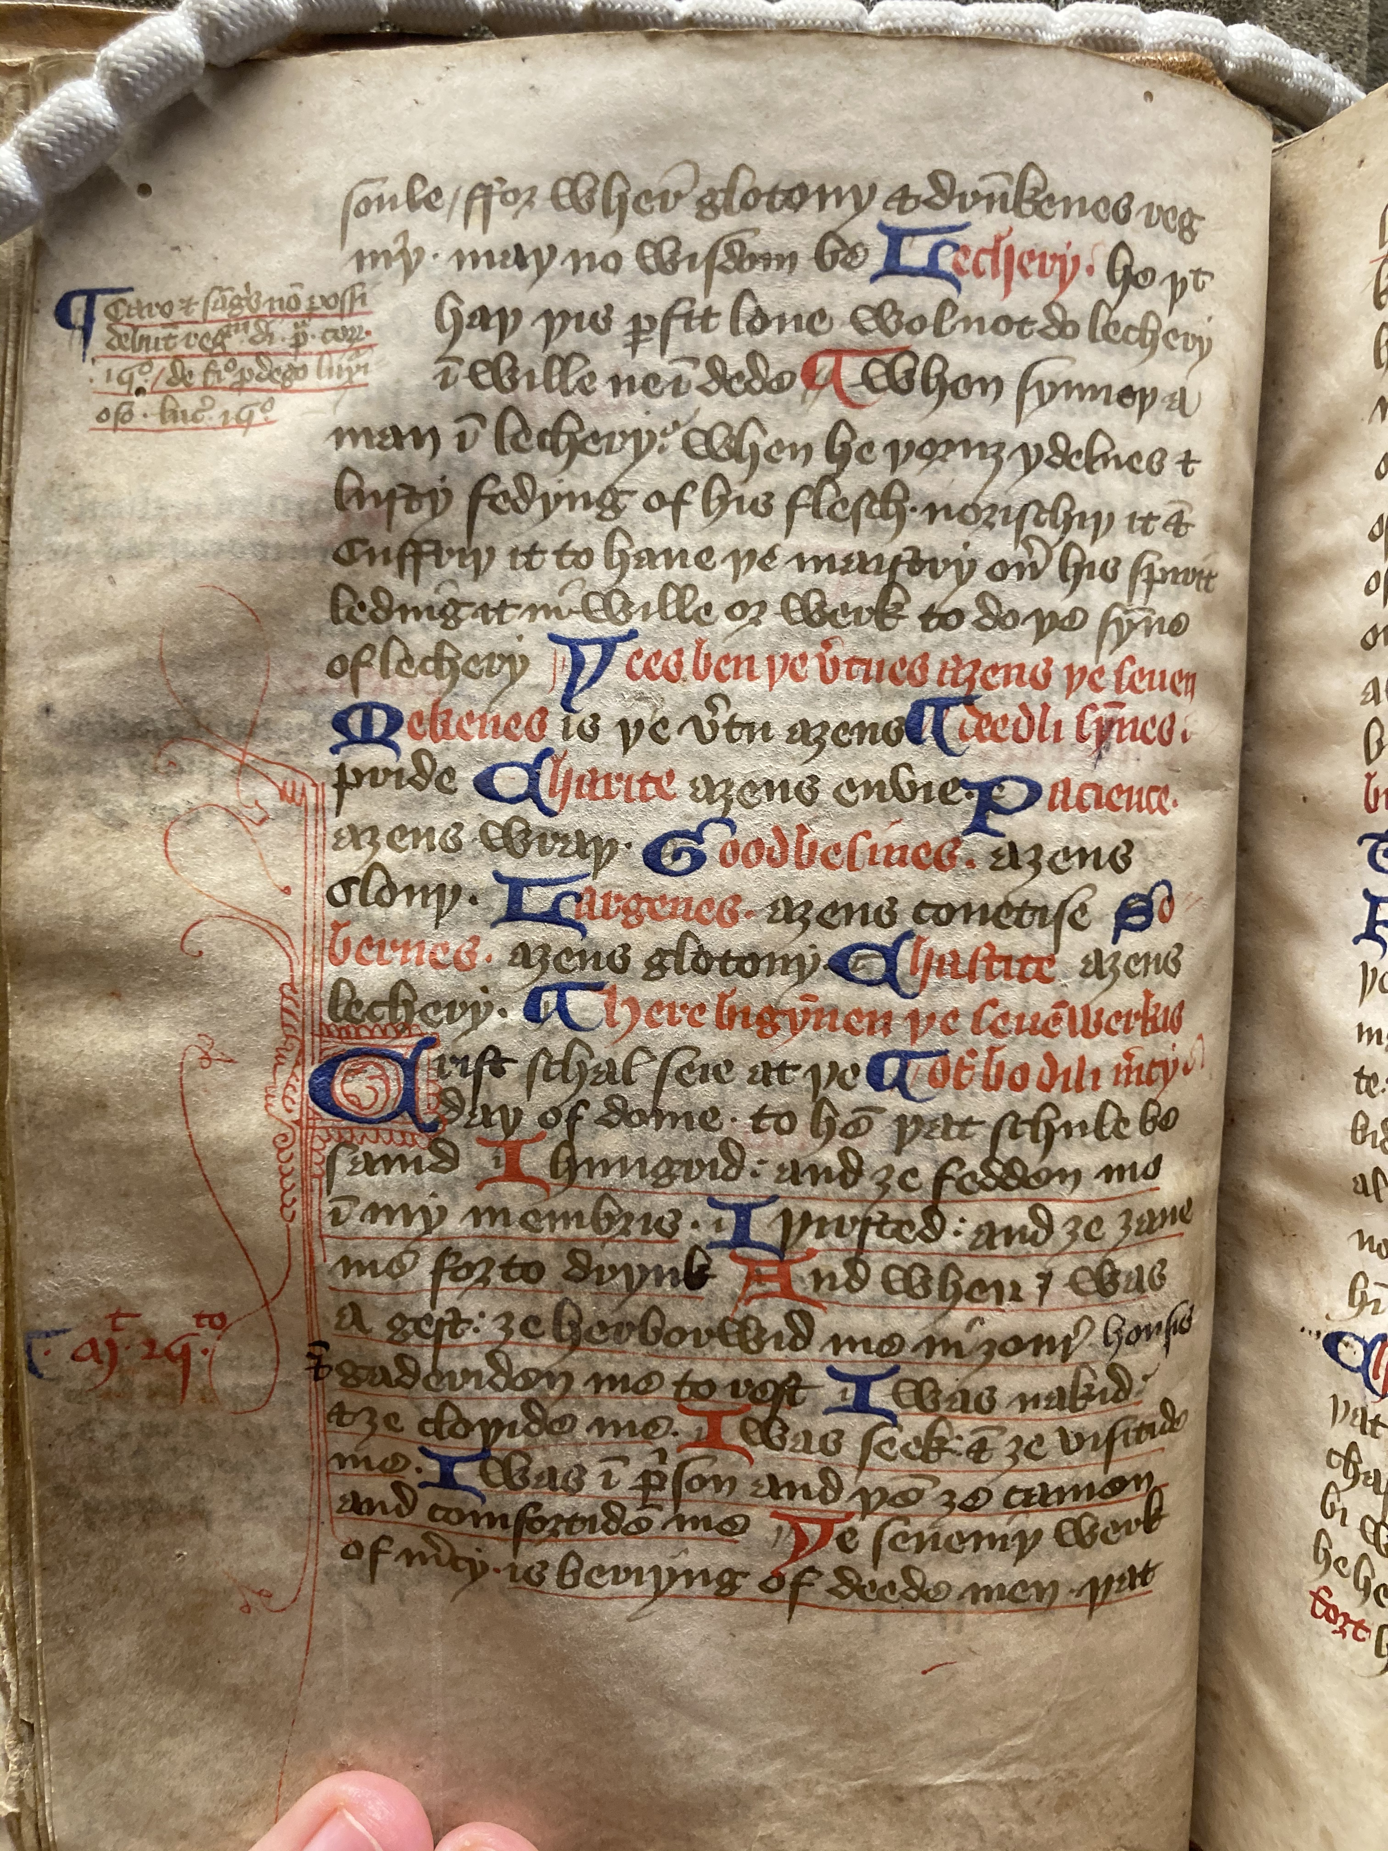
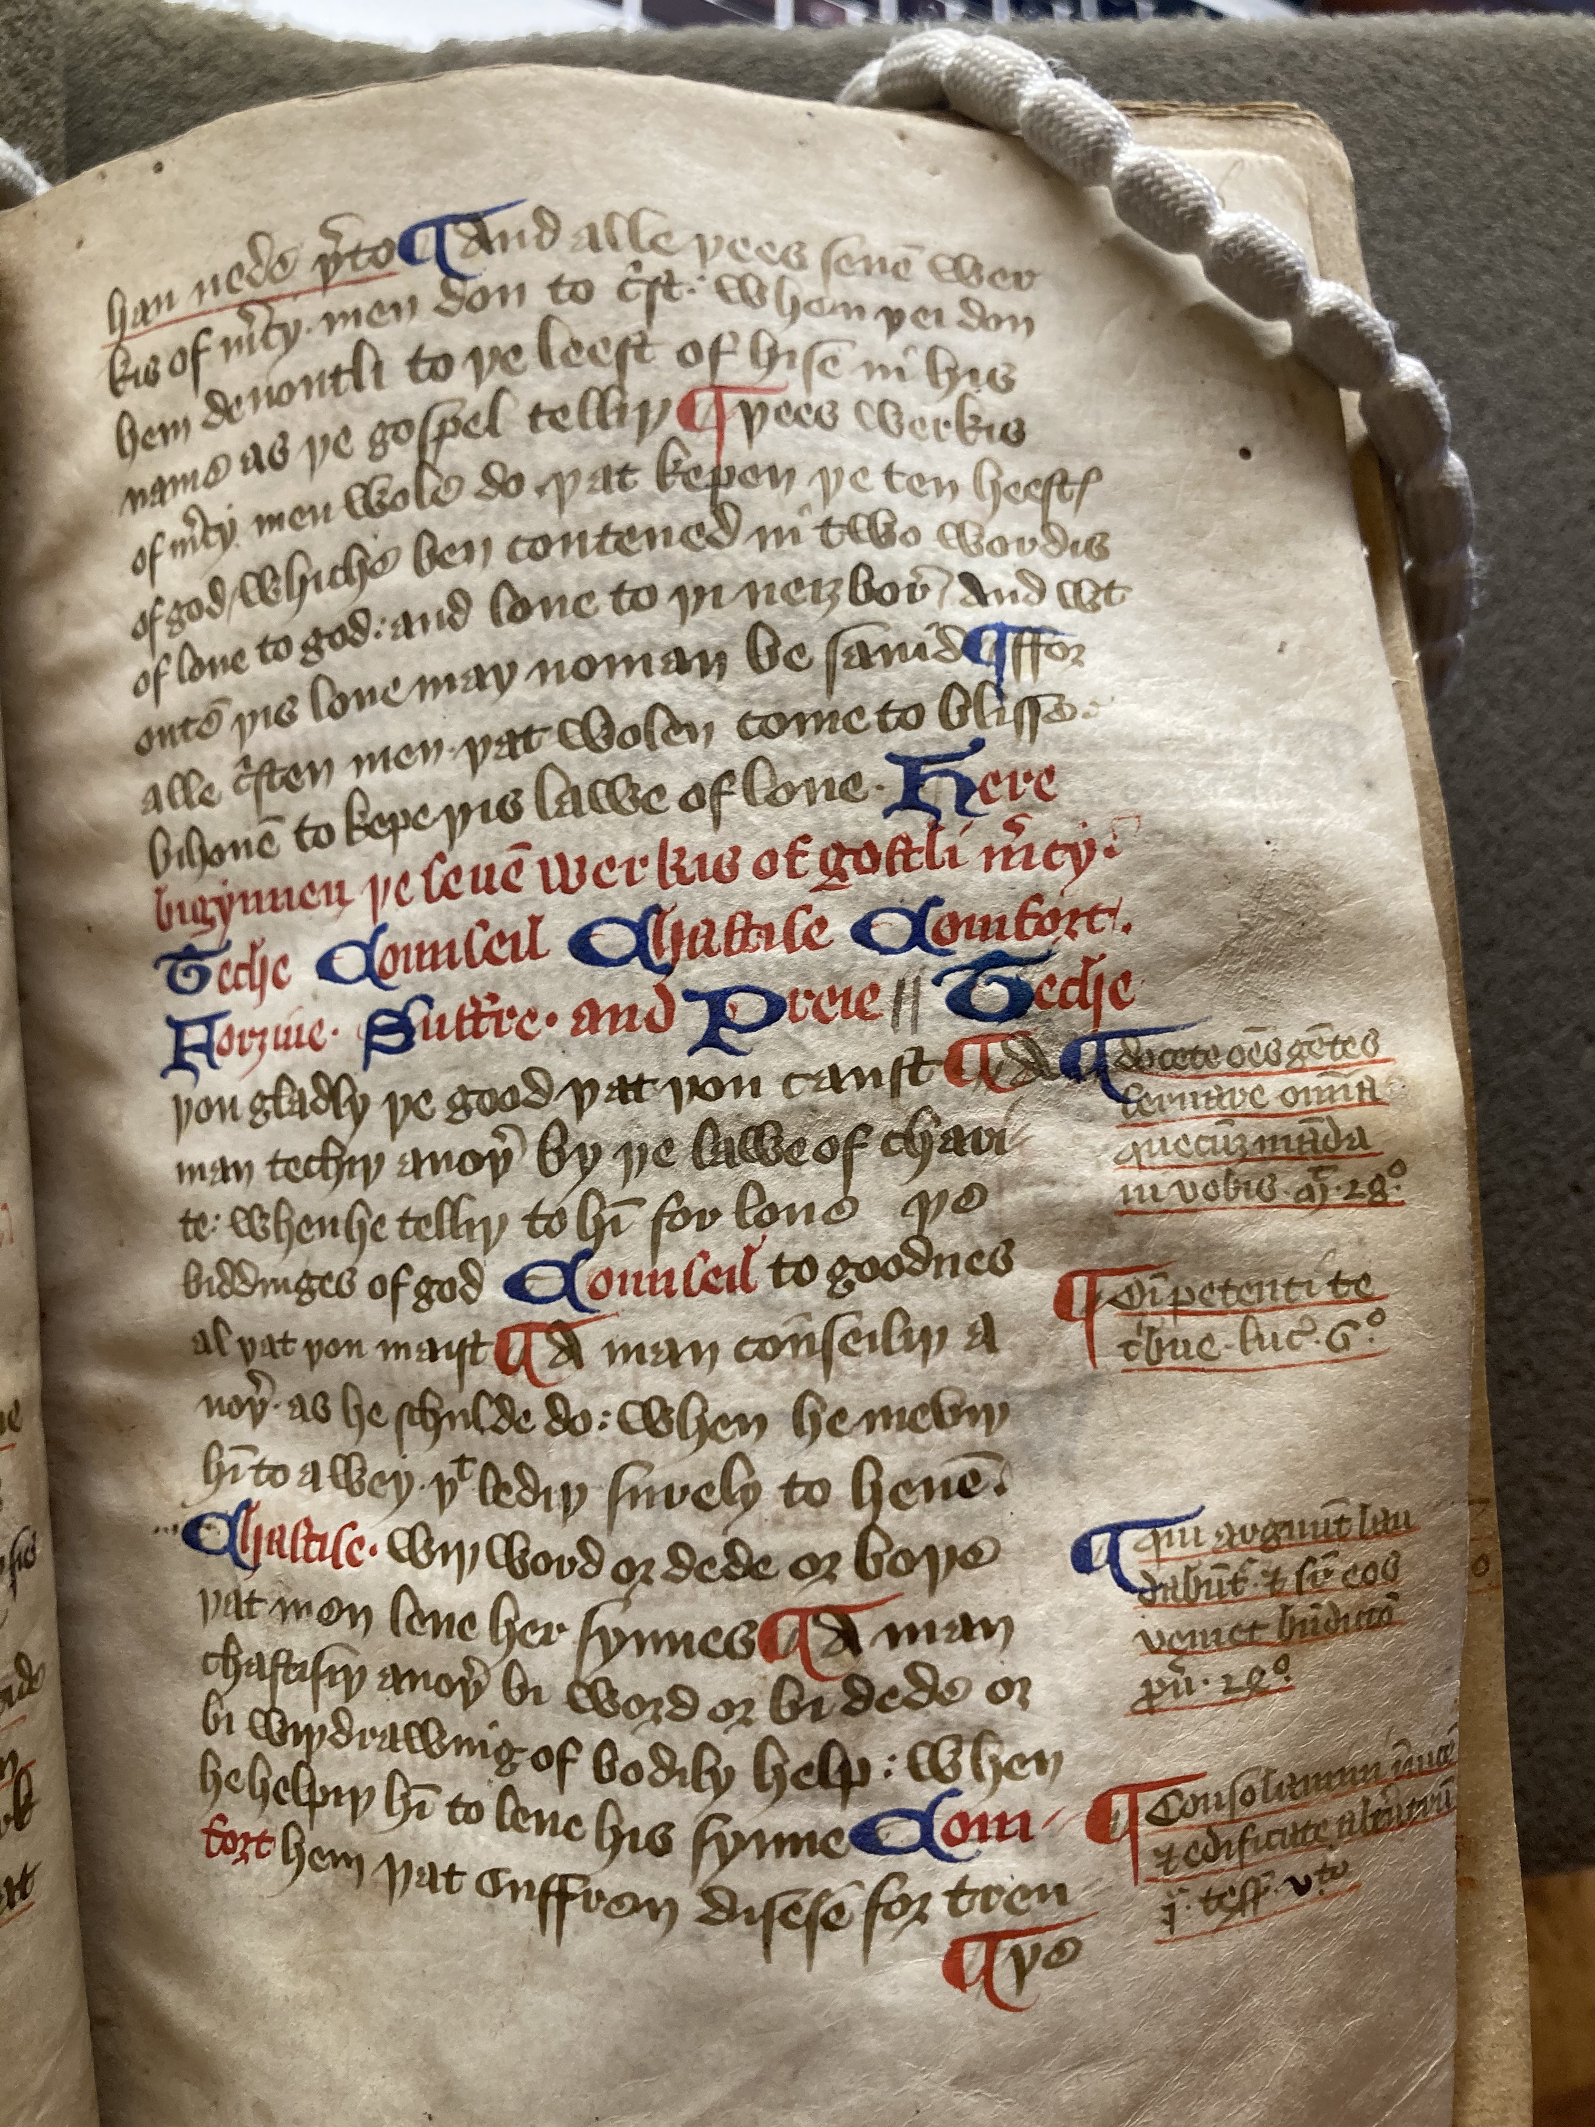
MS Bodley 938,
f. 5v beginning of the ‘Works of Bodily Mercy’
f.6r end of the ‘Works of Bodily Mercy’ beginning of the ‘Works of Ghostly Mercy ’
f.6v end of the ‘Works of Ghostly Mercy’ beginning of the ‘Gifts of the Holy Ghost’

Slide 7
Revelation 22:18-19
[Douay Rheims Translation]
[18] For I testify to every one that heareth the words of the prophecy of this book: If any man shall add to these things, God shall add unto him the plagues written in this book. [19] And if any man shall take away from the words of the book of this prophecy, God shall take away his part out of the book of life, and out of the holy city, and from these things that are written in this book.
From the Prologue to the Book of Isaiah in Lambeth Palace MS 1033
[Qtd. by Henry Hargreaves (“The Wycliffite Versions,” in The Cambridge History of the Bible vol. 2, ed. Lampe (CUP, 2008), 413]
Here endith the prologe on Isaye, and here bigynneth the text of Isaye. With a short glose on the derke wordis; and loke eche man, that he wryte the text hool bi itself, and the glose in the margin, ether leve it al out.

Slide 8
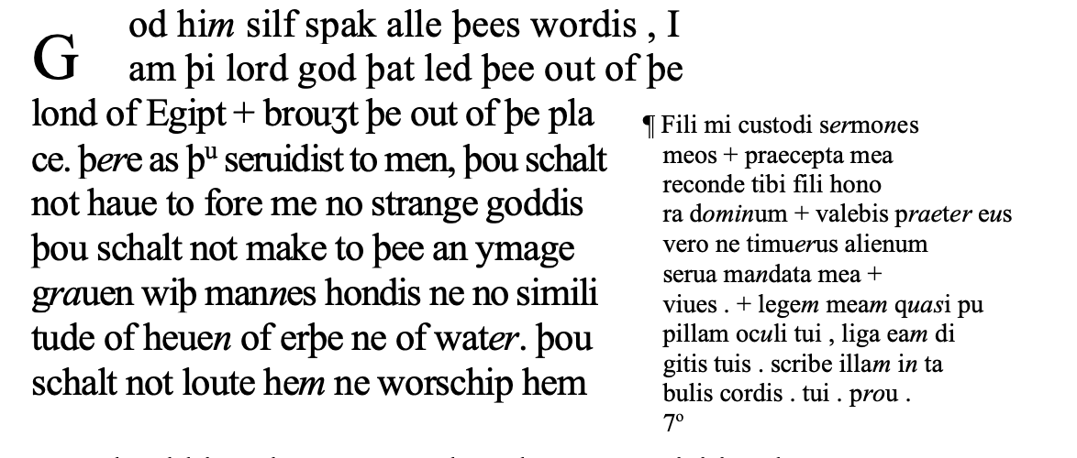
MS Bodley 938, f. 2r
“Fili mi, custodi sermones meos, et praecepta mea reconde tibi.” – Proverbs 7:1
“Fili honora Deum et valebis praeter eus vero ne timueris alienum serua” – Proverbs 7:1, in Parisinus MS lat. 11553 S.IX and Cavensis, MS Abb. 1 (14)

Slide 9
Conclusions
Mise-en-page as orchestrating a mode of thought
Can page design itself be instructive, or even dangerous?

