Slide 1
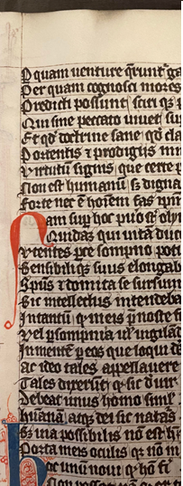
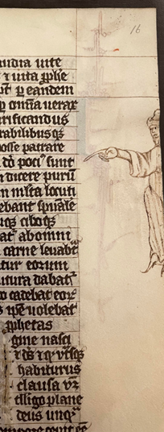
Glossing Book III of the Pseudo-Ovidian De vetula
Simon Whedbee & Rebecca Menmuir
Medieval commentary network, 2022
Bisected image: British library, additional ms 22014 (14th c), fol. 16r
De vetula, Book III

Slide 2
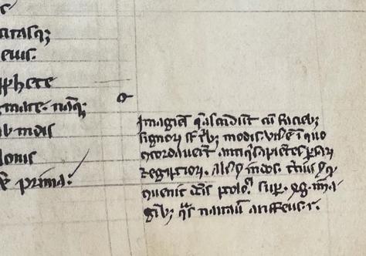
De vetula
Composed c. 1260s by recent estimations (certainly between 1222 – 1268)
French, likely associated with the University of Paris
Poem with three books, accessus and other prefatory material, stable corpus of glosses
Paratexts and glosses are likely authorial (Godman; Haynes)
BNF lat. 16252 (13th c ^{ex}), fol. 134r: r for Roger?

Slide 3
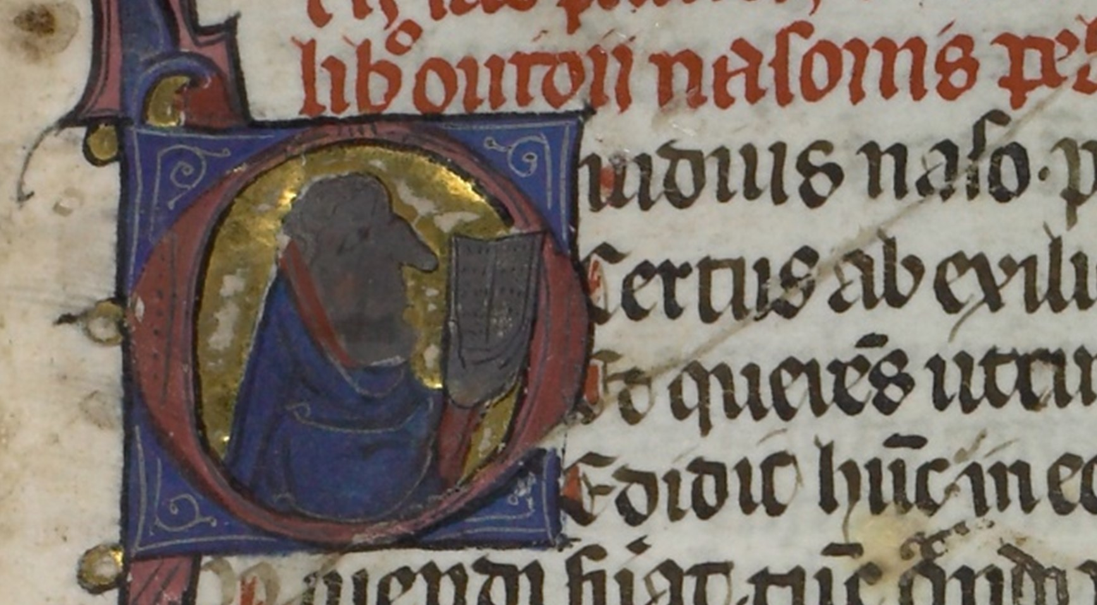
De vetula and the aetas Ovidiana
BL Harley 5263 (c. 1400), fol. 1r: A historiated initial containing Ovid’s profile, opening De vetula

Slide 4
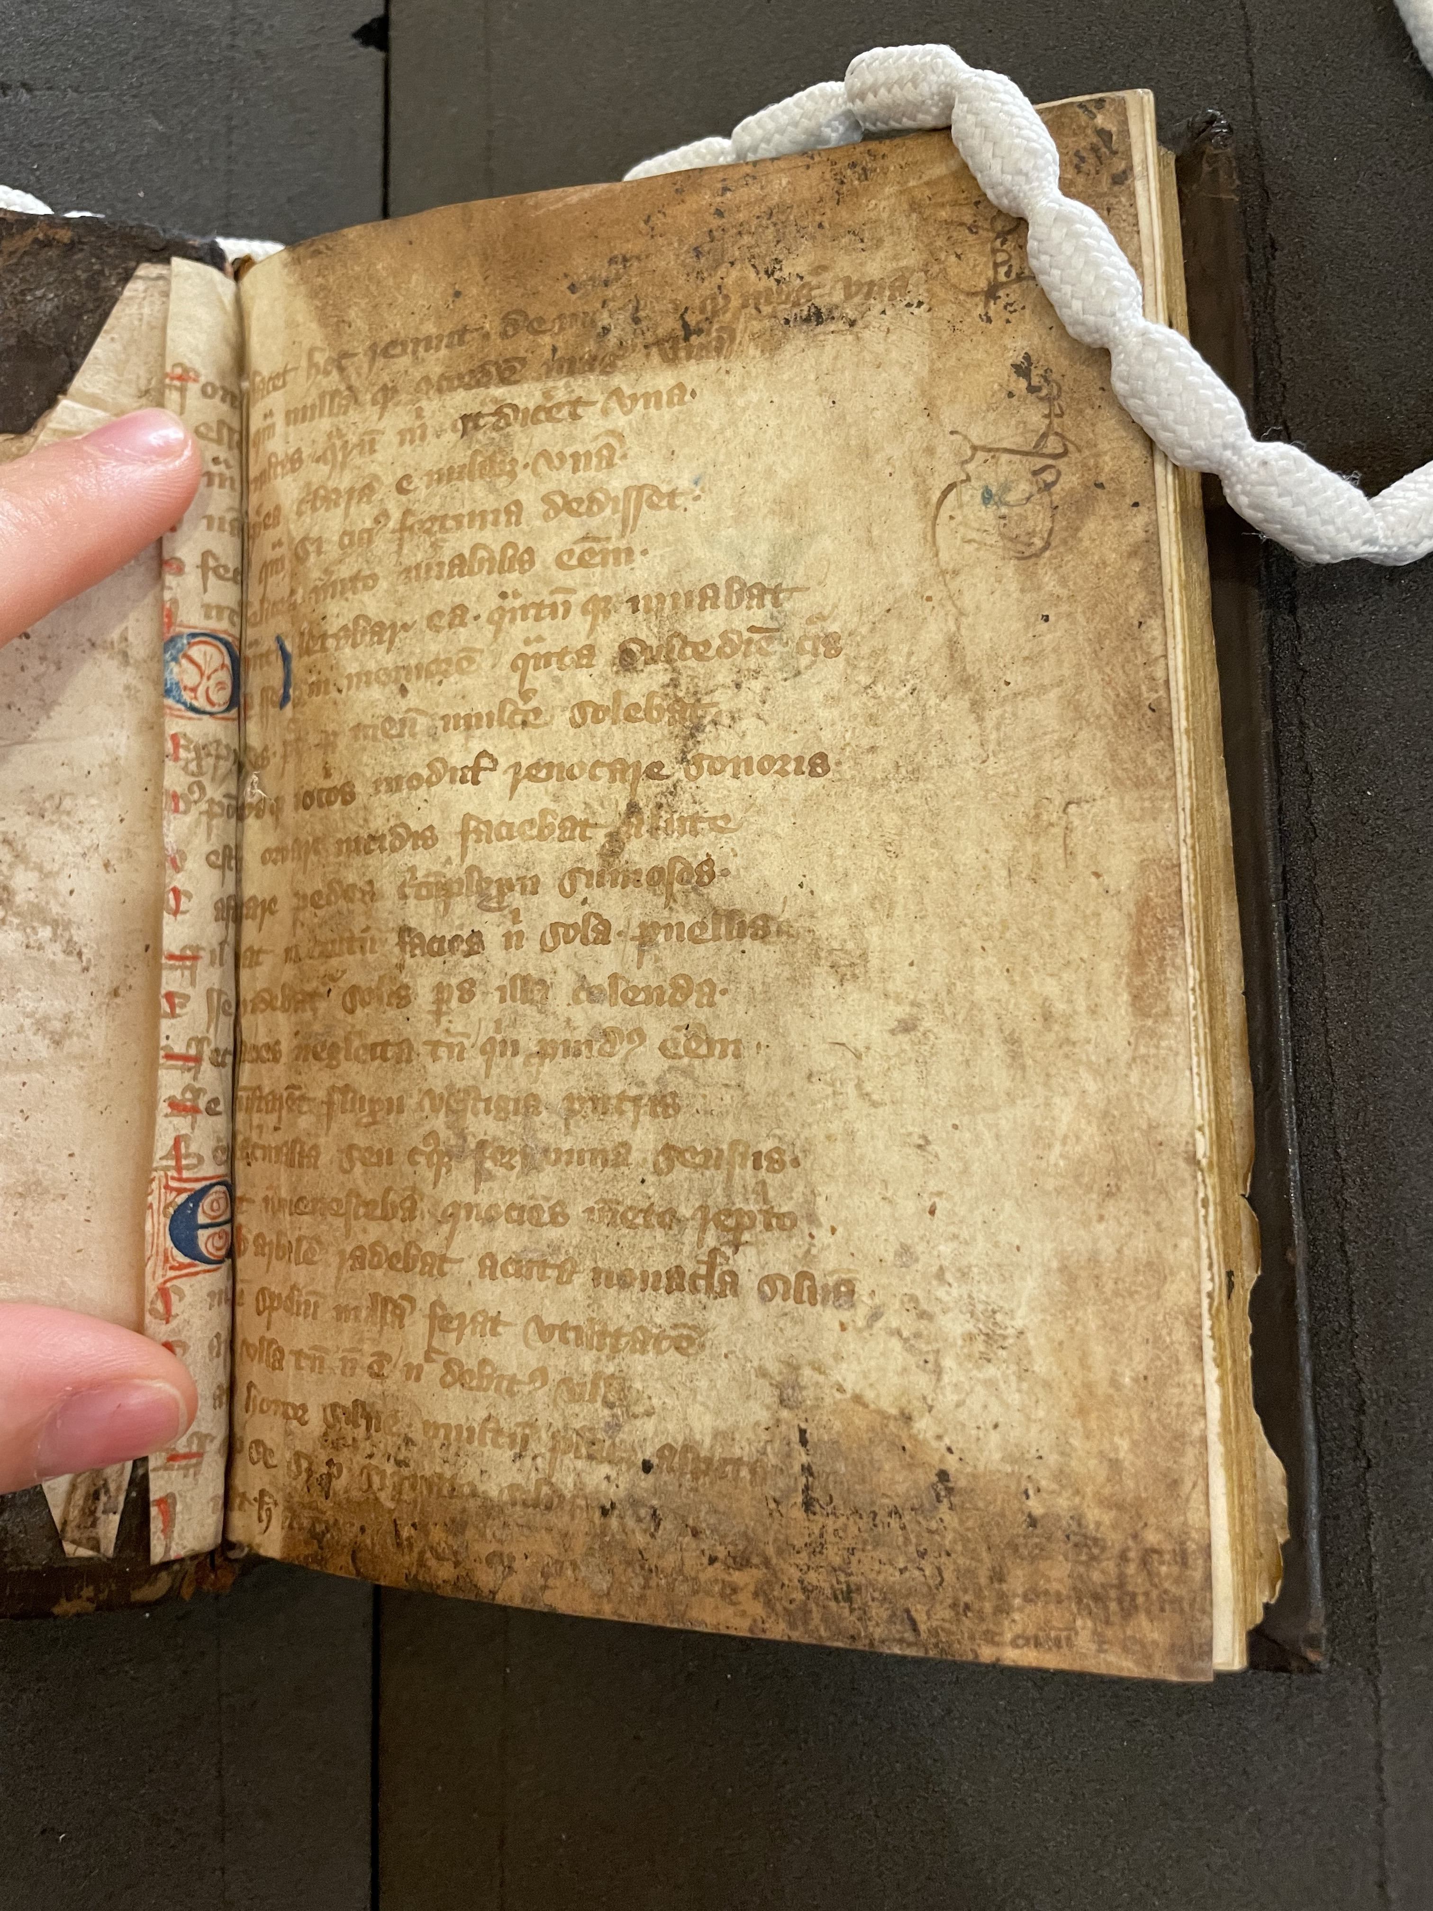
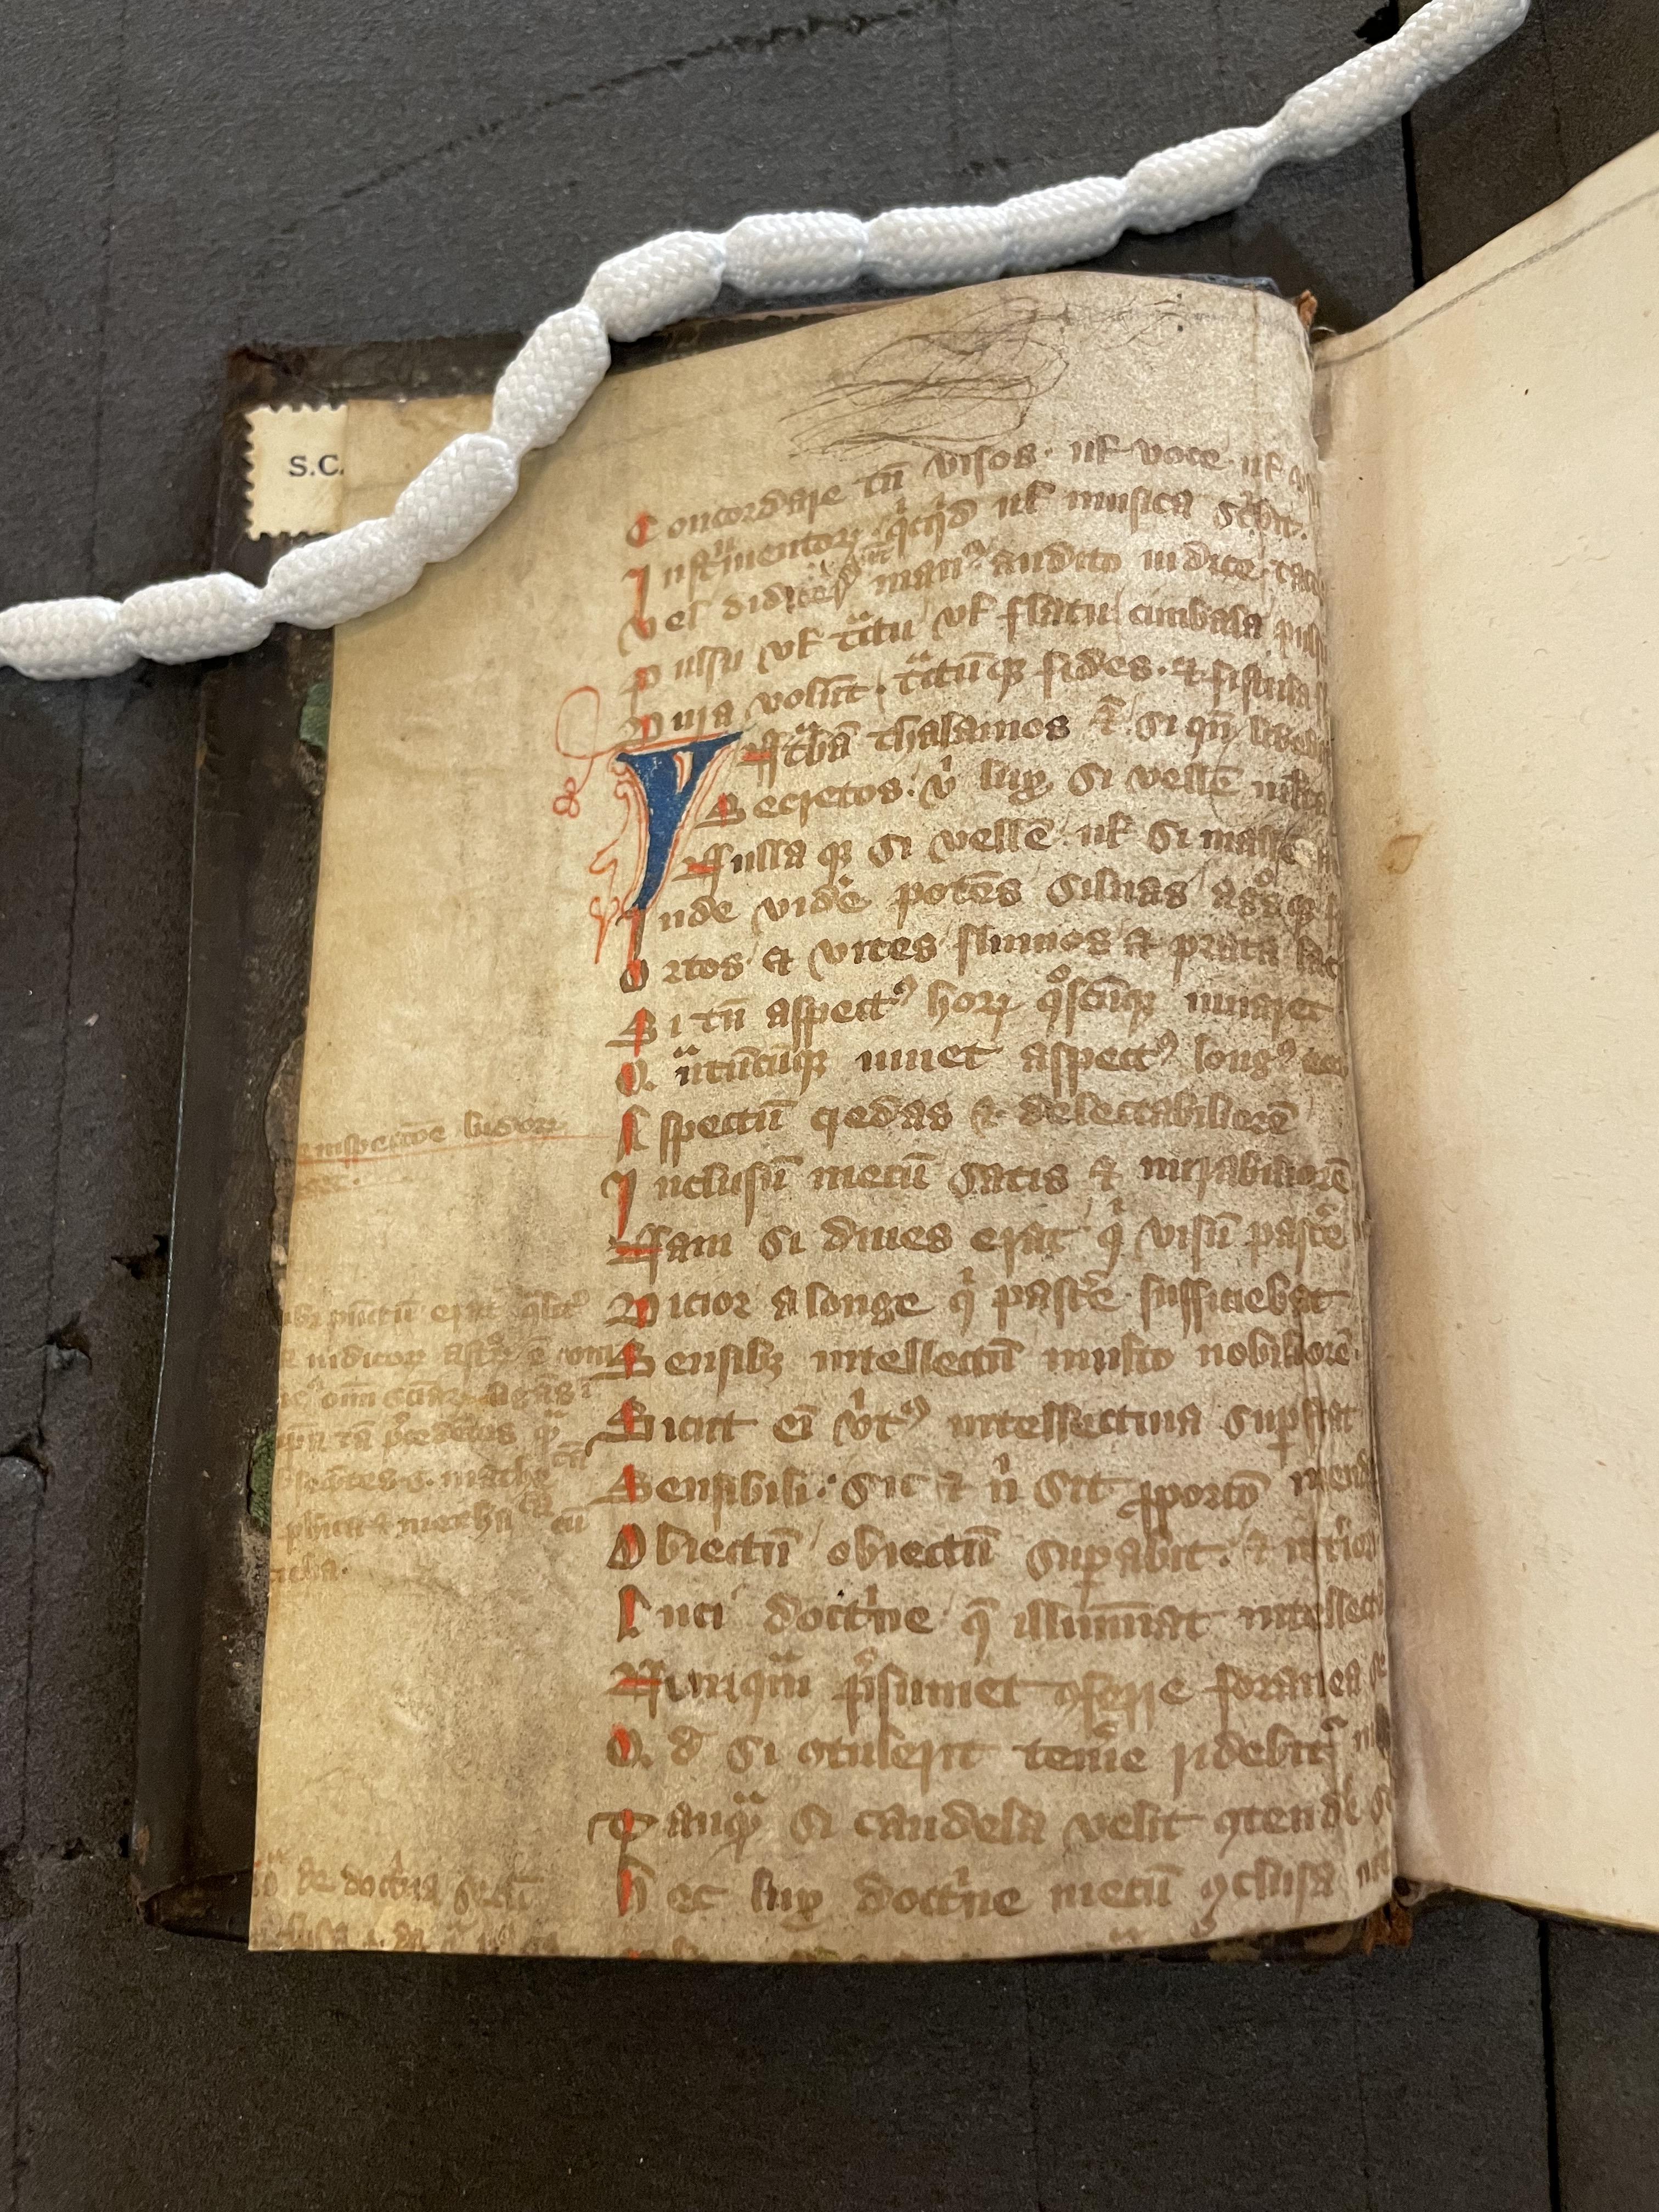

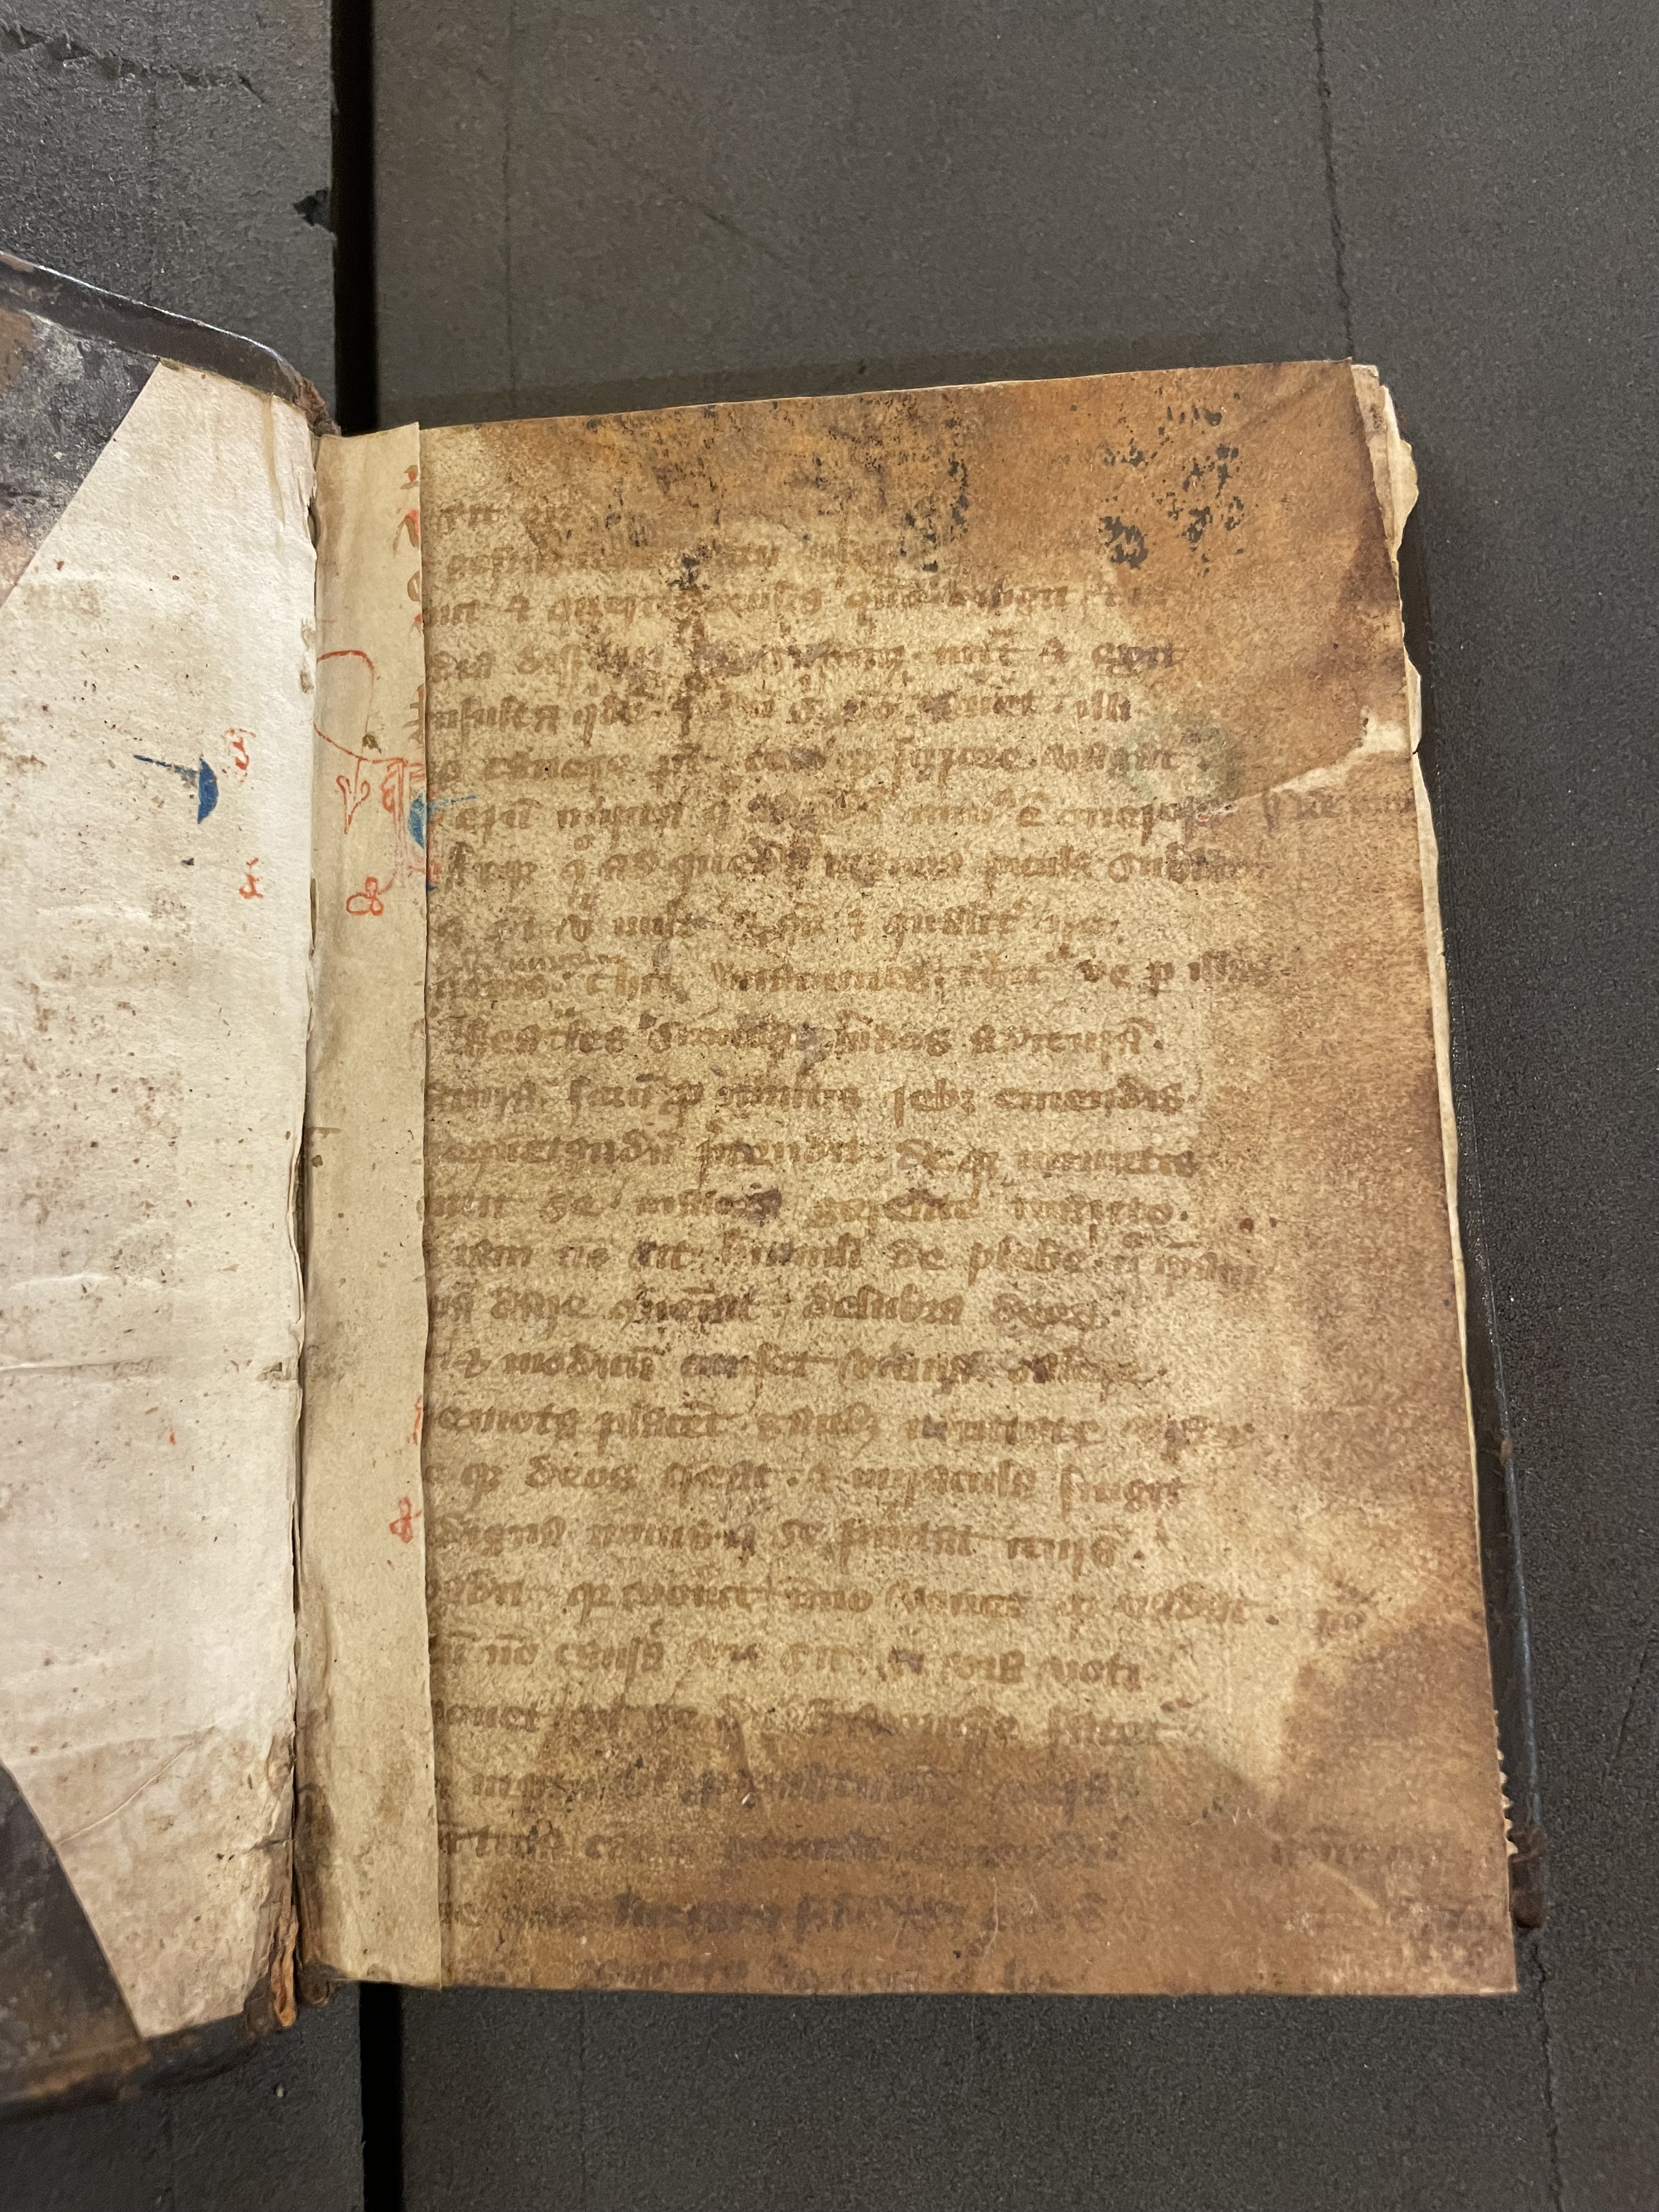
Accessus, praefatio x 2, introitus
Book I: “Ovid”’s youthful pastimes – hunting, fishing, dice, games
Book II: young “Ovid” pursues a woman via a go-between (the vetula), who tricks “Ovid” into sleeping with her
Book III: philosophical and scientific debates/calculations, prediction of the birth of Christ
Bodleian, MS Bodl. 612: 13th-c opening folios of De vetula used as pastedowns in 16th-c MS

Slide 5
The manuscripts of De vetula (a selection)
Shelfmark | Date | Containing
Paris, BNF lat. 16252 | 13th c (end) | Entire text
London Congregational Library I. f. 33 | 13th c (end, c. 1294) | Book III only
London, BL Arundel 384 | 14th c | Book III only
Paris, BNF lats 8256 + 14805 | 14th c | Entire text
London, BL Additional 22014 | 14th c | Entire text
London, BL Harley 5263 | 15th c (beginning, c. 1400) | Entire text
London, BL Harley 2745 | 15th c | Entire text
Cambridge, Jesus 70 (Q.G.22) | 15th c | Book III only
Cambridge, Sidney Sussex 56 | 15th c | Book III only
Cambridge, Trinity 0.8.24 | 15th/16th cs | Book III only
c. 47 MSS containing part or whole of De vetula, its paratexts, or its accessus
Book III frequently excerpted, particularly in the 15th c

Slide 6
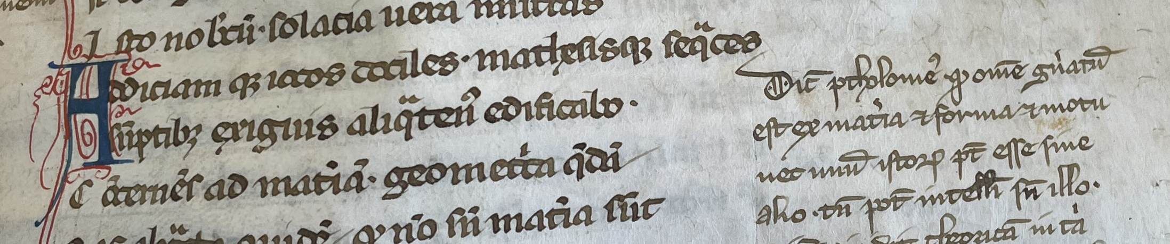
The glosses to De vetula, Book III
Poets and trivium writers
  e.g. Virgil, Statius, Donatus, Ovid
Philosophical and quadrivium writers
  e.g. Plato, Aristotle, Ptolemy
Example gloss: BNF lat. 14805 (14th c), fol. 119r (next to De vetula III. 22):
Dicit Ptholomeus quod omne generatum est ex materia et forma et motu…

Slide 7
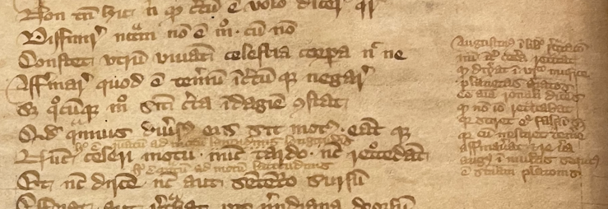
Four types of scholarly interests
Glosses dealing with Latin grammar and literary devices
Glosses relating superficial reading of the poem to an inner Catholic meaning
Glosses dealing with Latin grammar and literary devices
Glosses relating superficial reading of the poem to an inner Catholic meaning
Example gloss: BL Arundel 384 (14th c), fol. 223v (next to De vetula III. 48):
Augustinus in libro retractionum…

Slide 8
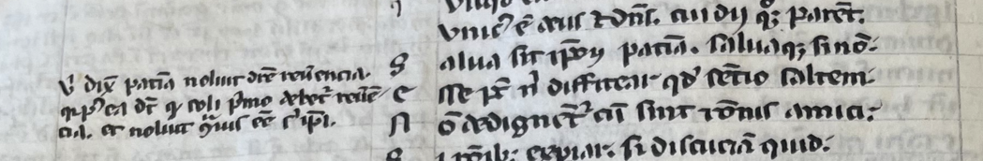
Example gloss: BNF lat. 16252 (13th c), fol. 128v (next to De vetula III. 70):
‘Ovid’/poem: Salva sit ipsorum patientia...
Gloss: Ubi dixit patientia noluit dicere reverentia…

Slide 9
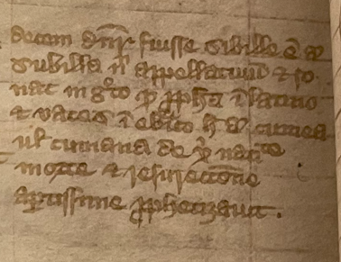
Glosses dealing with Latin grammar and literary devices
Poem: Sed, licet iste foret homo verus, non tamen ipse / nasci deberet sicut communiter illi / nascuntur . . . Haec sunt, quae cecinit Cumanae Musa Sibyllae
d
[But, although he would be a true human, nonetheless he should not have to be born in the way that those who are purely human are commonly born . . . This is what the Muse of the Cumaean Sibyl sang of recently in the holy city, as if the testimony of an eyewitness had giver her foreknowledge of all things]
f
Gloss: Decem dicuntur fuisse sibille. Est enim subilla nomen appellatiuum et sonat in Greco quod ‘propheta’ in Latino et ‘uates’ in Hebraice. Hec autem Cumea uel Cumana de Christi natiuitate, morte, et resurrectione apertissime prophetizavit.
f
[There are said to have been ten sibyls. ‘Subilla’ is a common noun and indicates in Greek the Latin word ‘prophet,’ which is in Hebrew ‘vates.’ This sibyl in the poem, however, is called ‘Cumaean’ or ‘Cumanean,’ and foretold the birth, death, and resurrection of Christ.]
BL Arundel 384 (14th c), fol. 231v: decem dicuntur fuisse sibille…

Slide 10
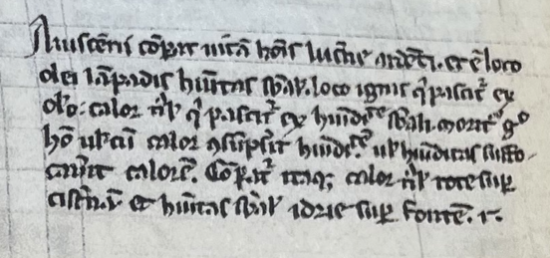
Glosses dealing with natural sciences
Poem: Rumpatur funis argenteus, atque recurrat / aurea virga, super contrita sit hydria fontem.
[The silver cord shall be broken, and the golden staff shall shrink back, and the pitcher shall be smashed at the fountain.]
Gloss: Avicenna comparat vitam hominis lucerne ardenti et est loco olei lampadis humanitas substantialis, loco ignis, qui pascitur ex oleo, calor naturalis, qui pascitur ex humiditate substantiali. Moritur ergo homo vel cum calor consumpserit humiditatem, uel humiditas suffocaverit calorem. Comparatur itaque calor naturalis rote super cisternam et humanitas substantialis hydrie super fontem.
BNF lat. 16252 (13th c), fol. 132r
[Avicenna compares human life to a burning lantern. And in this metaphor the lamp’s oil signifies human substance, while the fire that feeds from the oil signifies the natural heat that feeds on the body’s wetness. Thus, someone dies when their natural heat dries out their wetness or their wetness extinguishes the heat. Therefore, natural heat is compared in the poem to a wheel above a cistern and human substance is compared to a water-pot broken on a fountain.]

Slide 11
Glosses dealing with astrology
Poem: Dicuntur astrorum domini, quod in omnibus annis / viginti iunguntur Iuppiter et pater eius / cumque duodecies in signis triplicitatis / unius iuncti fuerint, seu tredecies ut / accidit interdum, tandem mutatur eorum ad succedentem coniunctio triplicitatem. Quarum consuevit coniunctio maxima dici, / quae fit in initio puncti vernalis, et ipsa / post quasi nongentos et sexaginta fit annos / ipso Saturno bis sex decies revoluto / significans nunc diluvium, nunc aeris ignes, / nunc terrae motus, nunc annonae gravitates, / regnorumque vices permutat et imperiorum. / Ast alibi quae fit mutata triplicitate / consuevit dici maior coniunctio, sectam / significans mutansque fidem per climata quaedam ; / et fit post annos quasi quadraginta ducentos. [De vetula III. 596-609]
Gloss: Investigaturus qualiter per scientiam iudiciorum posset venire in cognitionem secte prime[??] future, incipit a coniunctione duorum individuorum alteriorum, scilicet Saturni et Iovis. Et hec fit tribus modis. Vna est qua iunguntur in omnibus 20 annis in quocumque signo eo, quod Saturnus percurrit circulum in quasi 30 annis et Iuppiter in 20. Vnde fit ut post 20 annos iungantur in nono signo ab eo, in quo primus iuncti fuerant. Et post alios 20 in quinto a primo. Et post tertios 20 iterum in illo primo. Et hec vocatur ‘coniunctio magna’ et significat super multa, plerumque quidem super gravitatem annone et interdum super sublimationem regum et violentum[??] et super nativitates prophetarum. Quoniam autem signa primum, quintum, et nonum faciunt triplicitatem, postquam totiens in ista triplicitate coniuncti fuerint, quod mutantur ad aliam triplicitatem, tunc vocatur ‘coniunctio maior’ significans super apparitionem prophete et mutationem fidei sive secte…

Slide 12
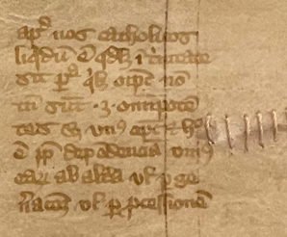
Glosses dealing with Catholic theology and the eschaton
Poem: Arguo sic igitur: duo si sunt omnipotentes / ac per id equales, aut hic dependet ab illo / aut non . . . Tantum est igitur Deus unus / strenuus, excelsus, super omnia glorificandus.
[Therefore I argue as follows: if there are two omnipotent beings and in this respect equal, then either one is subordinate to the other or not . . . Therefore, there is only one God, vigorous, lofty, and worthy of veneration above all things.]
Gloss: Apud nos Catholicos liquidum est quod licet in trinitate sit persona quelibet omnipotens, non tamen sunt tres omnipotentes, sed unus omnipotens. Et hoc est propter earum dependentiam unius ad alteram uel per generationem vel per processionem. nm
[Among us Catholics it is clear that, although there is a certain almighty person in the Trinity, nevertheless there are not three almighties, but one single almighty. And this follows according to their dependency of one on the other either through generation or through procession.]
BL Arundel 384 (14th c), fol. 224r: apud nos catholicos…

Slide 13
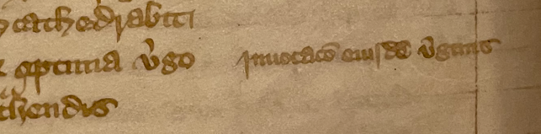
Concluding thoughts
Breadth and depth of knowledge
Supplementing the text and skirting the issue of anachronisms
Directed to ‘Ovid’ or the reader?
BL Arundel 384 (14th c), fol. 232v
Poem: optima virgo
Gloss: invocatio eiusdem virginis

Slide 14
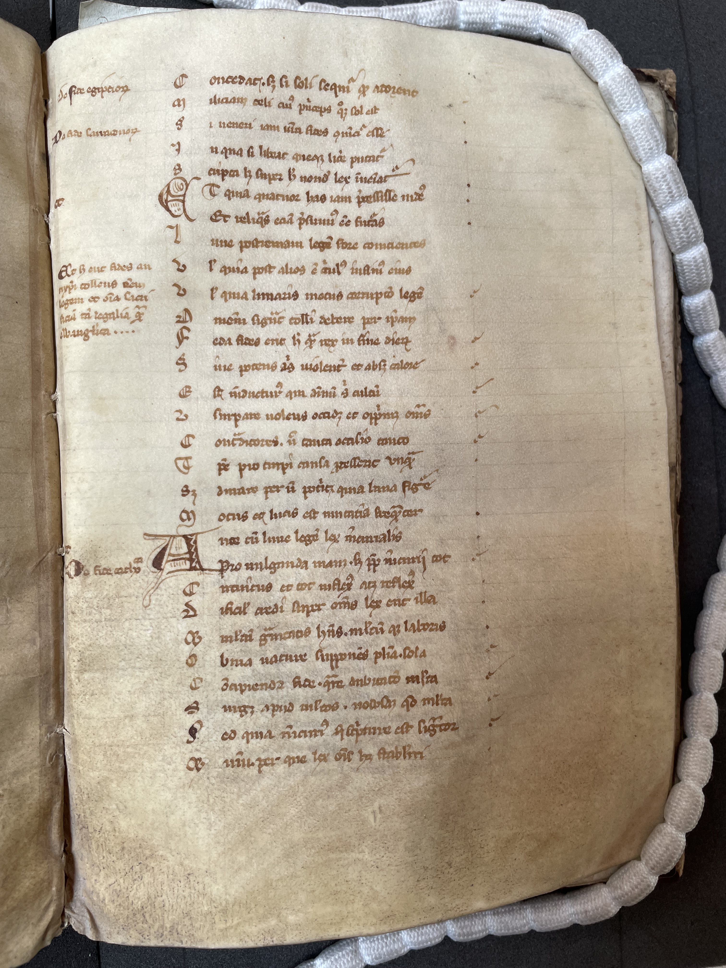
What are the glosses to Book III doing?
They expound typical and atypical knowledge;
Their presence lends authenticity to forgery;
But their details expose the forgery further;
How might a pagan writer earn his Christian salvation?
London Congregational Library, MS I. f. 33 (13th c, c. 1294), fol. 72r

