Slide 1
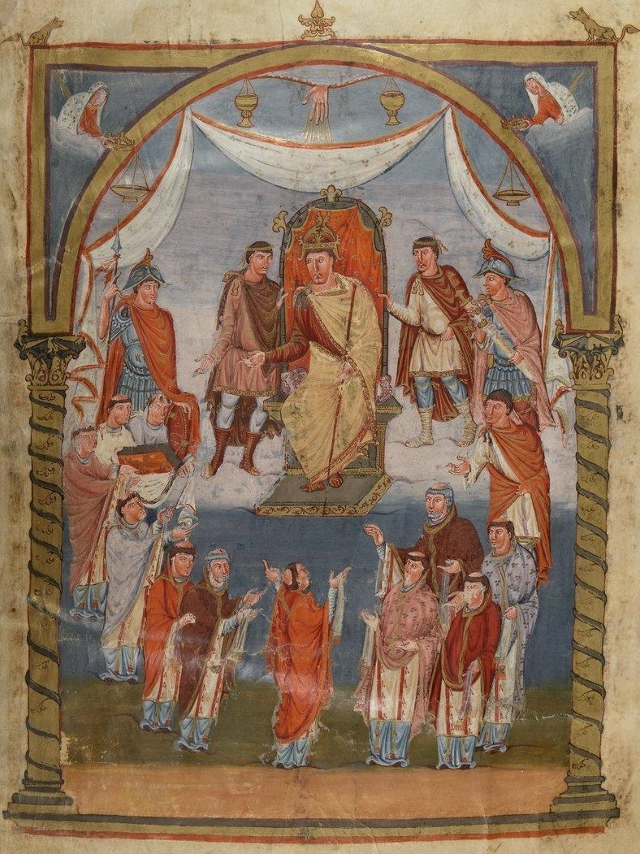
Biblical commentary and royal patronage in Carolingian Europe
Zachary Guiliano
OMCN, 16 May 2022

Slide 2
Sudden increase in exegetical manuscripts
Many patristic texts survive from the period.
More than 50 authors known from 768-9, with hundreds of works written and thousands of manuscripts preserved.

Slide 3
Gregory,
Homilia in Evangelia 40
‘Poverty and illness together wore Lazarus down.
Moreover, he saw the rich man making his way surrounded by throngs of attentive followers, while he was visited by no one…’

Slide 4
The cost of commentary
‘Each copy of the Gospels alone cost as much as a marble sarcophagus. The setting up of a library stocked with texts of the holy scriptures and with their commentaries (not to mention other Christian writings) left a footprint of real wealth. It was an act of monumentalisation that was as costly as the building or redecorating of a villa.’
  —Peter Brown, Through the Eye of a Needle

Slide 5
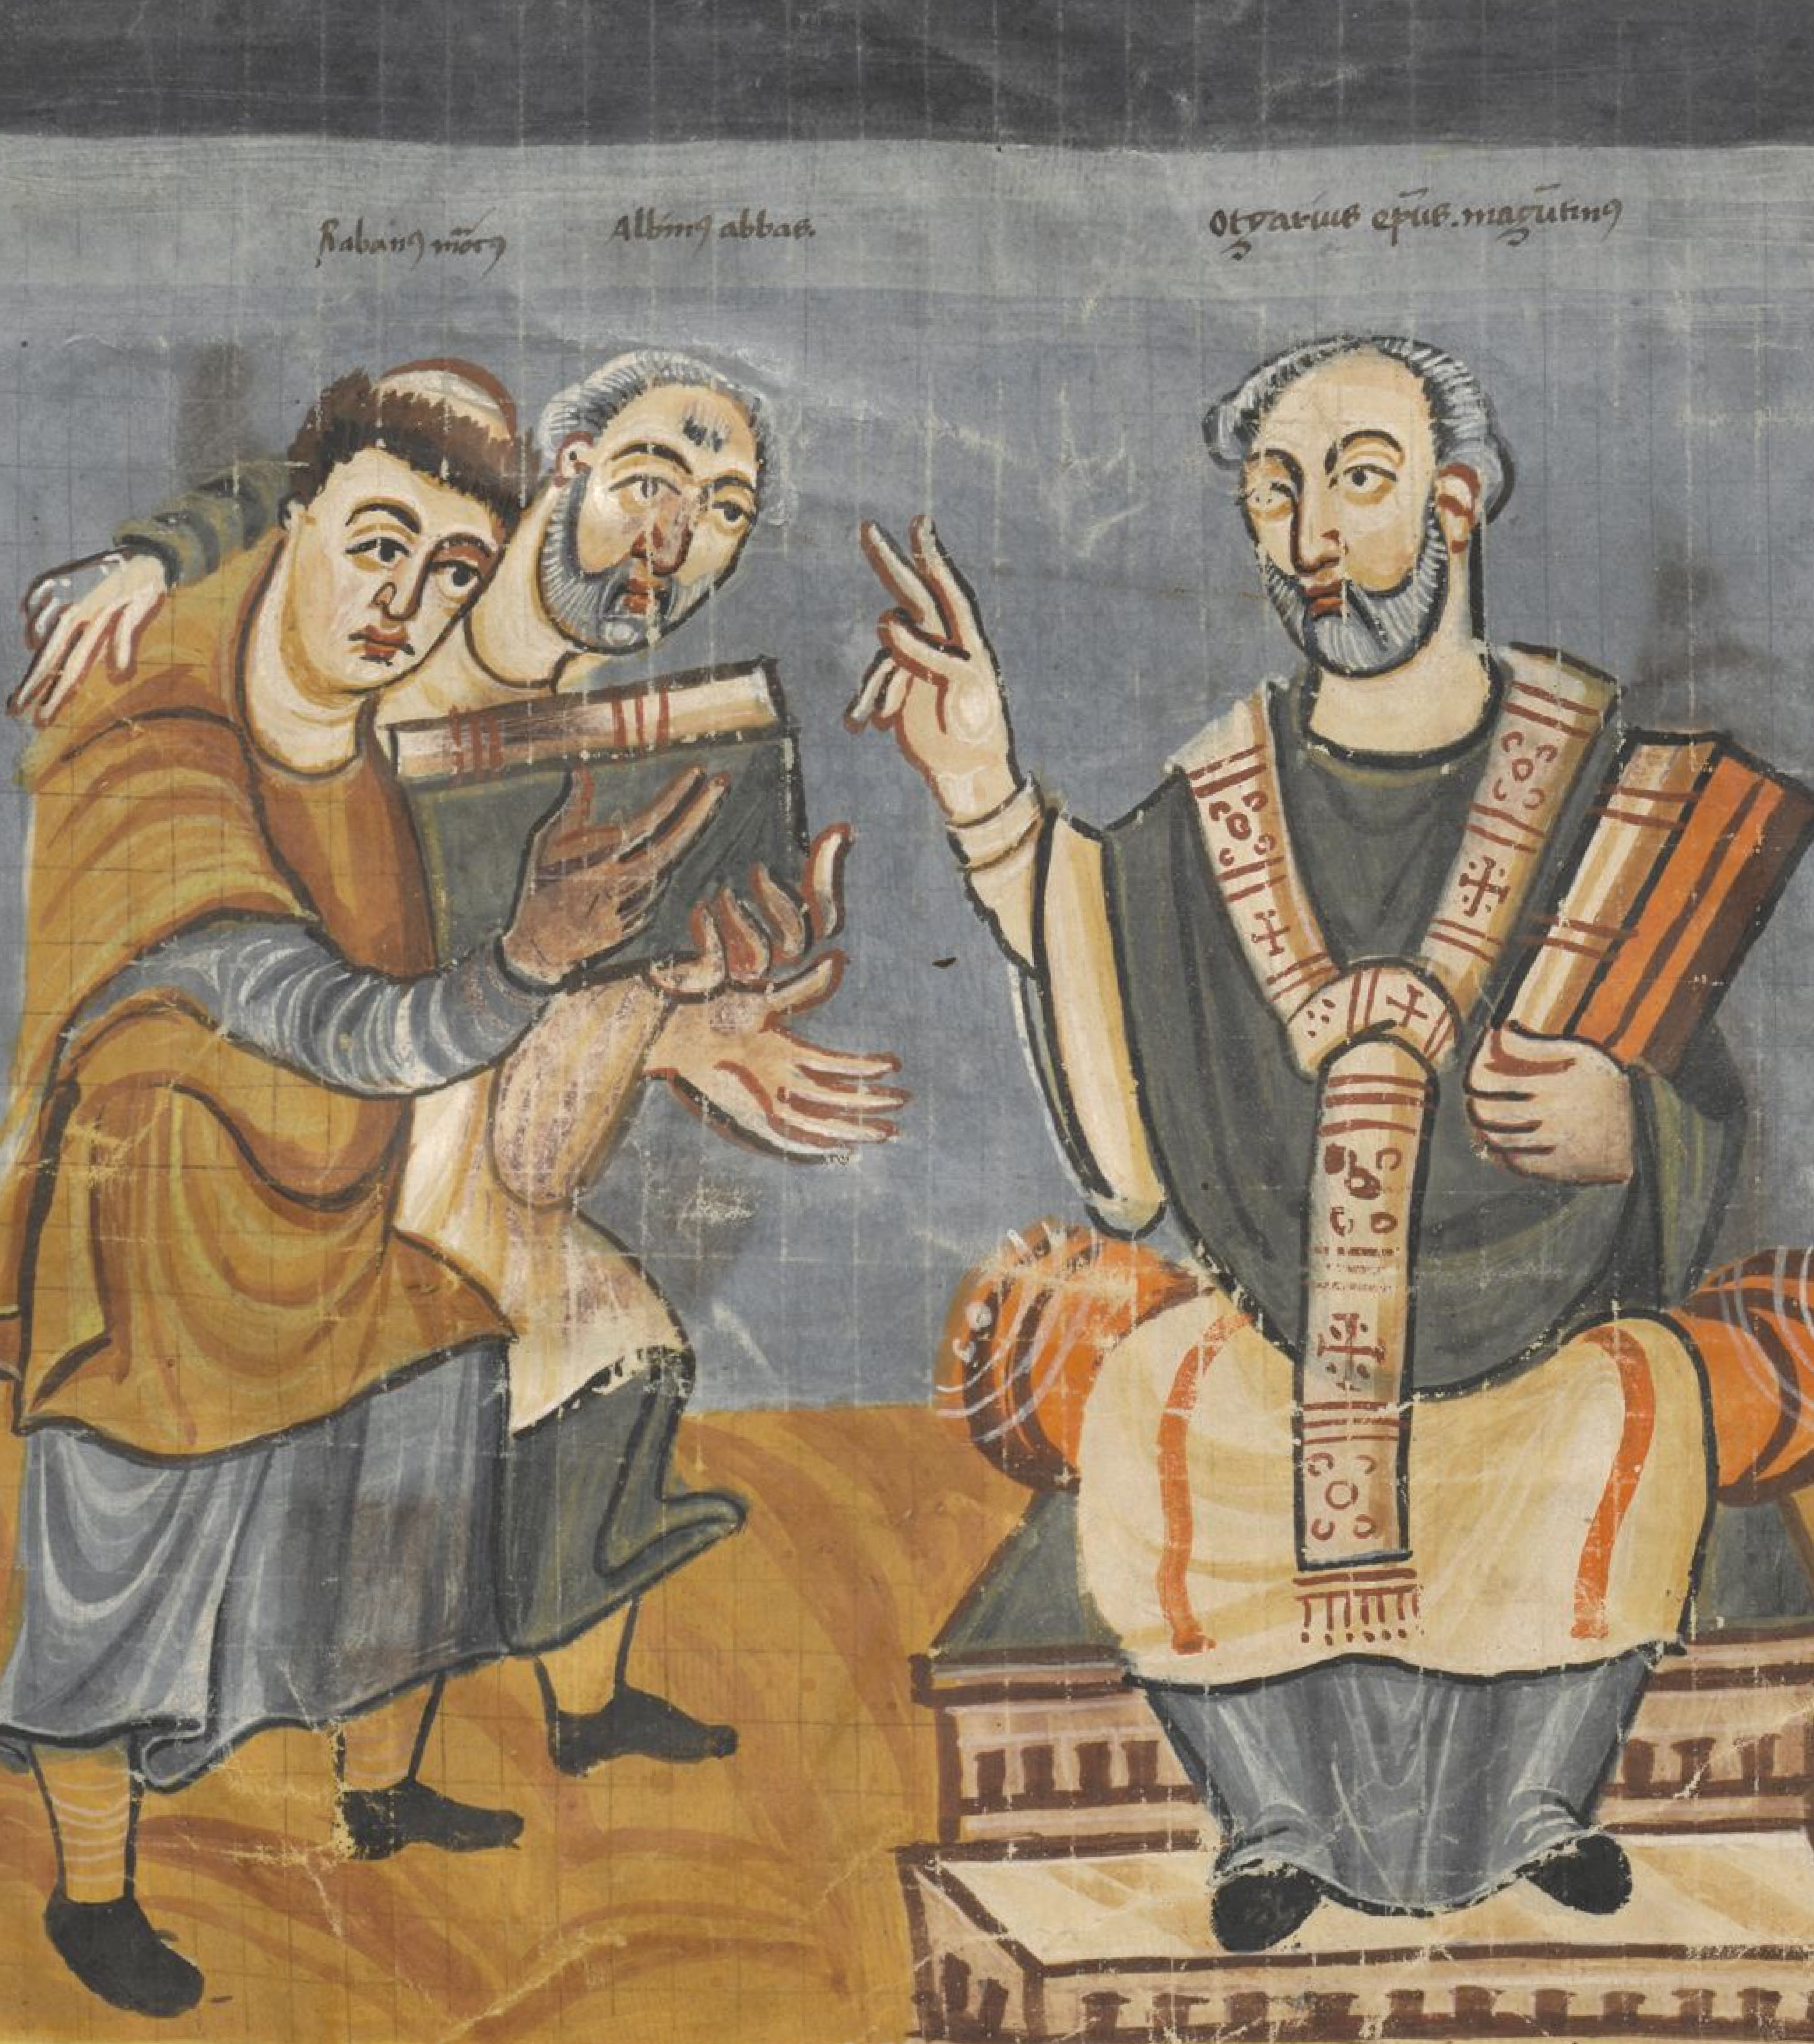
Carolingian scholars and patrons

Slide 6
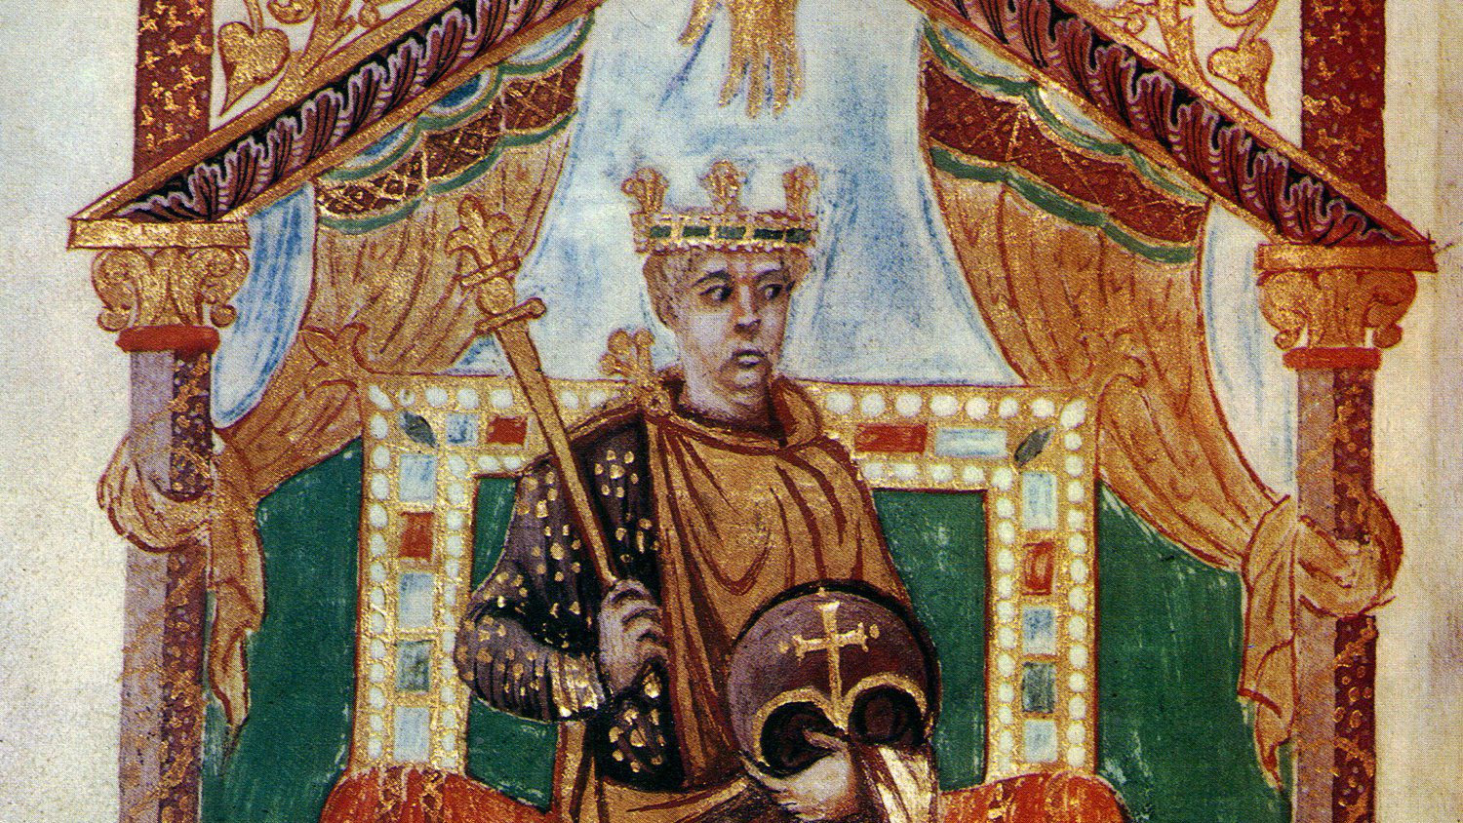
Eriugena’s work:
A patron’s influence?

Slide 7
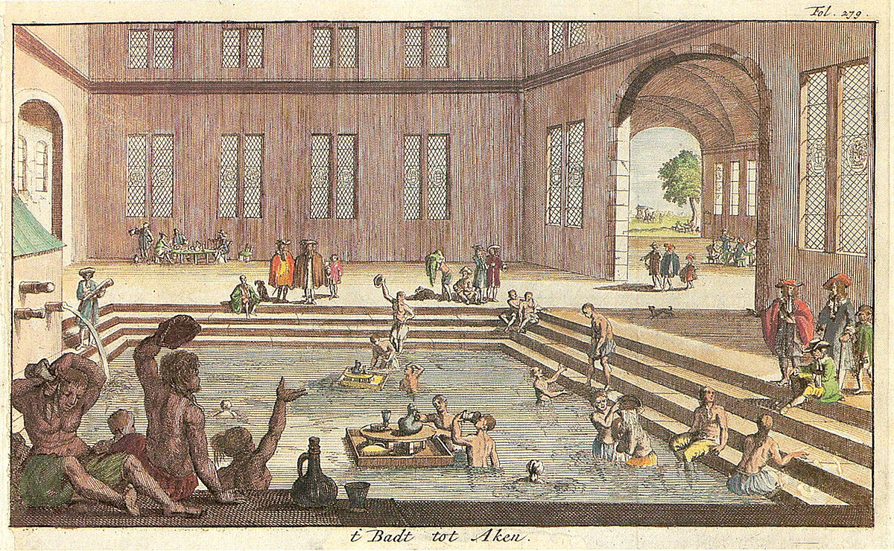
Patronage at the bathhouse

Slide 8
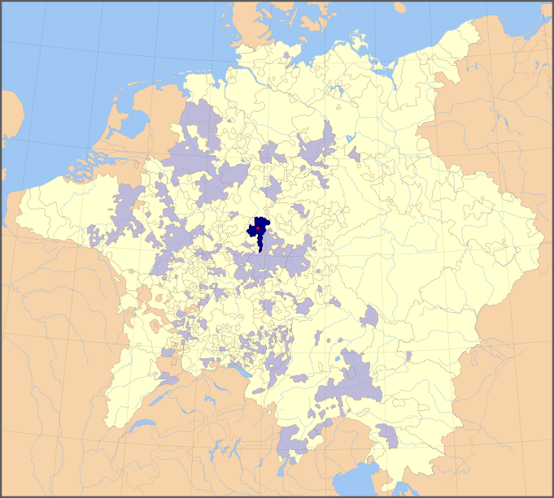
Early modern lands of Fulda Principality

Slide 9
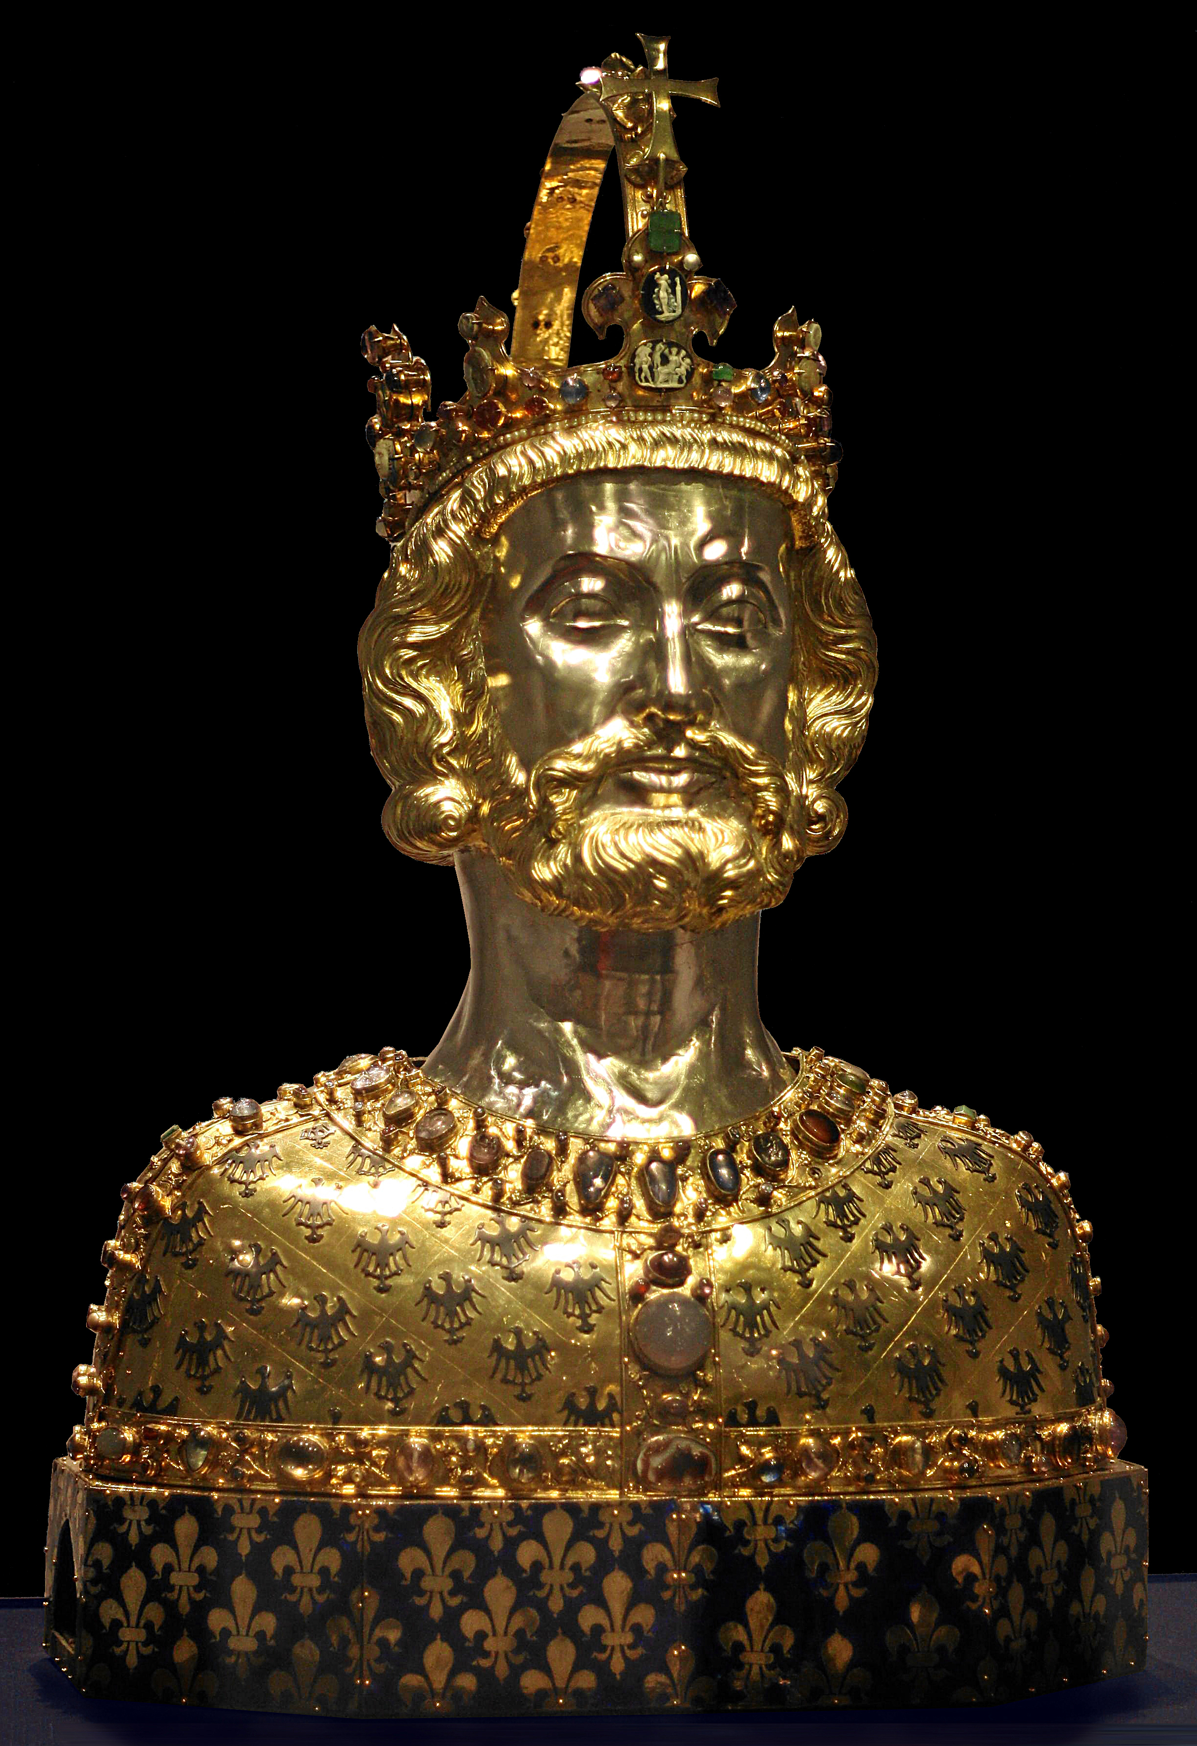
Charlemagne the commentator

