Slide 1
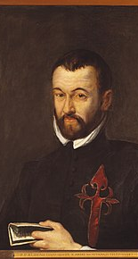
From curiosa to criticism:
Benito Arias Montano and Encyclopaedism in Sixteenth-Century Biblical Commentary
Maria Czepiel

Slide 2
Encyclopaedism in late 16th/ early 17th century Europe
Encyclopaedism in late 16th century Spain
Benito Arias Montano and the treatises of the Antwerp Polyglot

Slide 3
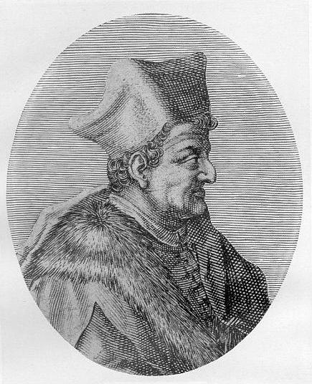
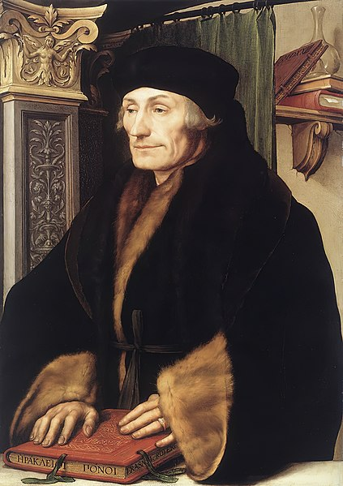
Biblical Humanism in the 16th century
End of 15th, beginning of 16th centuries. Philology:
Lorenzo Valla (1407-1457)
Desiderius Erasmus (1466-1536)

Slide 4
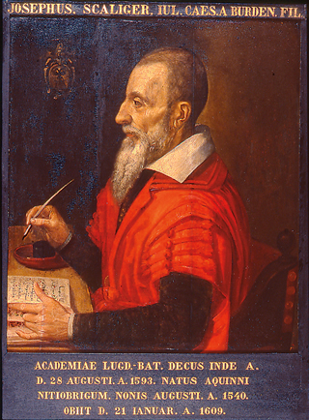
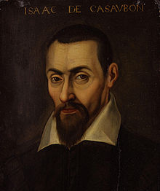
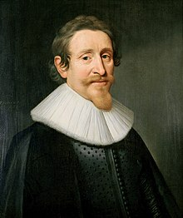
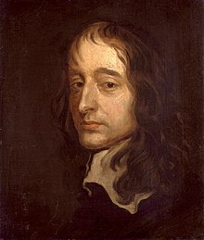
Biblical Humanism in the 16th century
End of 16th, beginning of 17th centuries.
Encyclopaedism:
Joseph Justus Scaliger (1540-1609)
Isaac Casaubon (1559-1614)
Hugo Grotius (1583-1645)
John Selden (1584-1654)

Slide 5
Biblical encyclopaedism and its connection to the commentary genre
curiosa and secular learning develop into treatises in their own right
Did Adam and Eve have navels?
What season was it when the earth was created?
What fruit did they eat?

Slide 6
Disciplines of Biblical Encyclopaedism
‘Mosaic physics’
Dissatisfaction with Aristotelian natural philosophy leads to ‘pia philosophia’
Relationship to commentary tradition (especially hexameral)
Biblical antiquarianism
Antiquitates: 15th and 16th centuries
Biblical antiquarianism: from the 1580s?

Slide 7
Encyclopaedism in late 16th/ early 17th century Europe
Encyclopaedism in 16th century Spain
Benito Arias Montano and the treatises of the Antwerp Polyglot

Slide 8
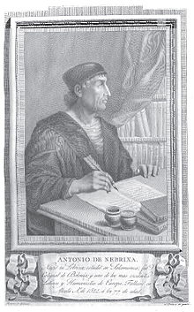
Biblical Humanism in Spain in the 16th century
Complutensian Polyglot: philology
Antonio de Nebrija: burgeoning encyclopaedism

Slide 9
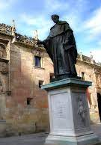
Biblical Humanism in Spain in the 16th century
The Salamanca Hebraists: Luis de León, Martín Martínez de Cantalapiedra, Gaspar de Grajal
Cantalapiedra: an encyclopedic manifesto
‘Tanto administrorum satellitio, ac comitatu Theologia nostra stipata ac comitata est, ut vix inveniri possit aliquis, qui dignus hoc nomine censendus sit’

Slide 10
Encyclopaedism in late 16th century Europe
Encyclopaedism in 16th century Spain
Benito Arias Montano and the treatises of the Antwerp Polyglot

Slide 11
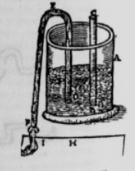
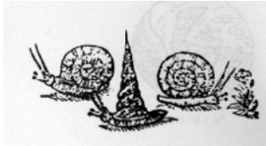
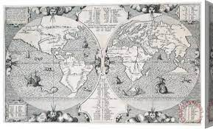
Arias Montano (ca. 1525-1598)
Naturae historia
Antiquarian treatises of the
Antwerp Polyglot

